Slide 1
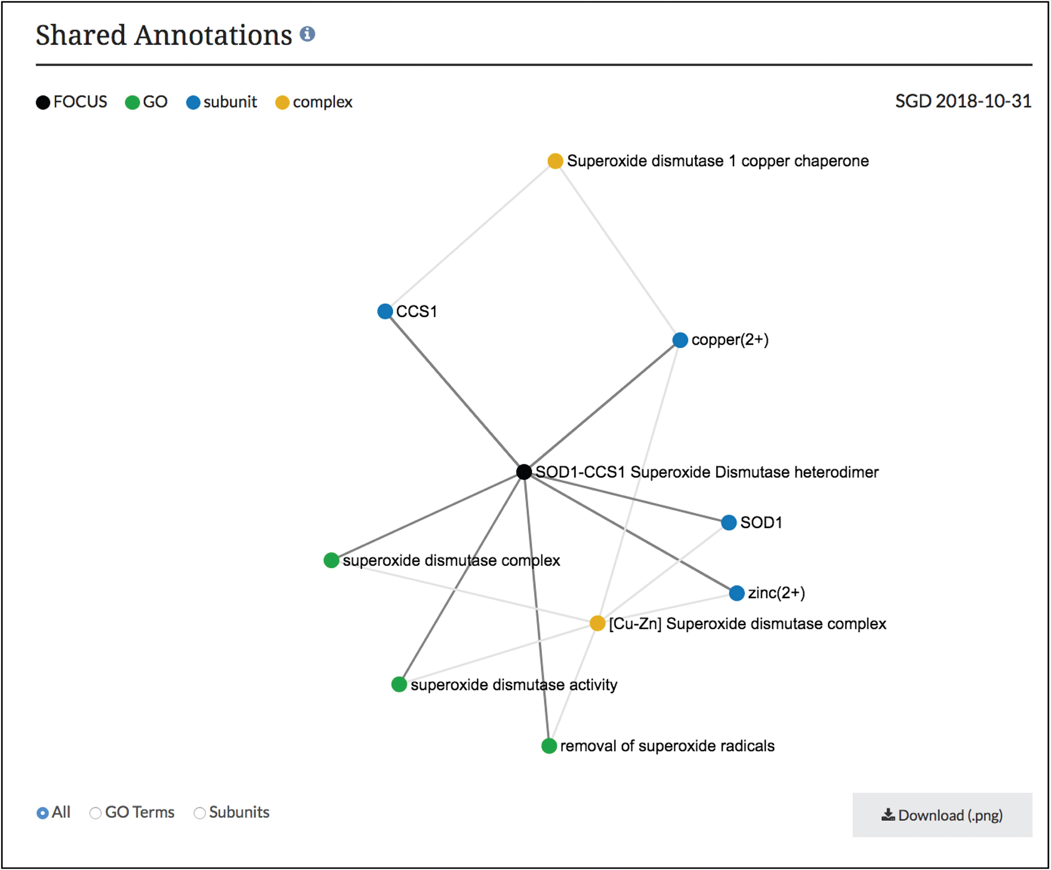
Figure 3 Network diagram of SOD1-CCS1 superoxide dismutase heterodimer page. GO annotations and complex subunits that ...
Notes:
Figure 3 Network diagram of SOD1-CCS1 superoxide dismutase heterodimer page. GO annotations and complex subunits that are shared between the focus complex and other complexes are shown as a network. Users can select to see shared GO terms or shared subunits individually or both. Images can be downloaded as .png files.
Unless provided in the caption above, the following copyright applies to the content of this slide: © The Author(s) 2019. Published by Oxford University Press.This is an Open Access article distributed under the terms of the Creative Commons Attribution License (http://creativecommons.org/licenses/by/4.0/), which permits unrestricted reuse, distribution, and reproduction in any medium, provided the original work is properly cited.

