Slide 1
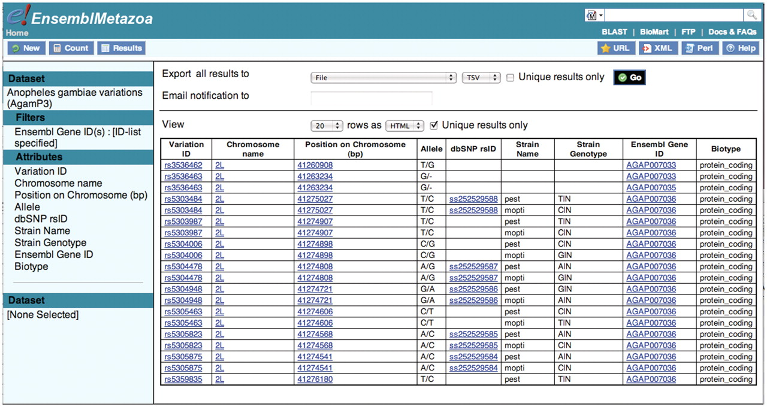
Figure 6. Having first retrieved the Ensembl gene IDs for the three APL1 genes, these are used to filter the A. gambiae ...
Notes:
Figure 6. Having first retrieved the Ensembl gene IDs for the three APL1 genes, these are used to filter the A. gambiae data set. Fifty variations were retrieved that lie within the three genes of the APL1 locus.
Unless provided in the caption above, the following copyright applies to the content of this slide: © The Author(s) 2011. Published by Oxford University Press.This is Open Access article distributed under the terms of the Creative Commons Attribution Non-Commercial License (http://creativecommons.org/licenses/by-nc/2.5), which permits unrestricted non-commercial use, distribution, and reproduction in any medium, provided the original work is properly cited.

