Slide 1
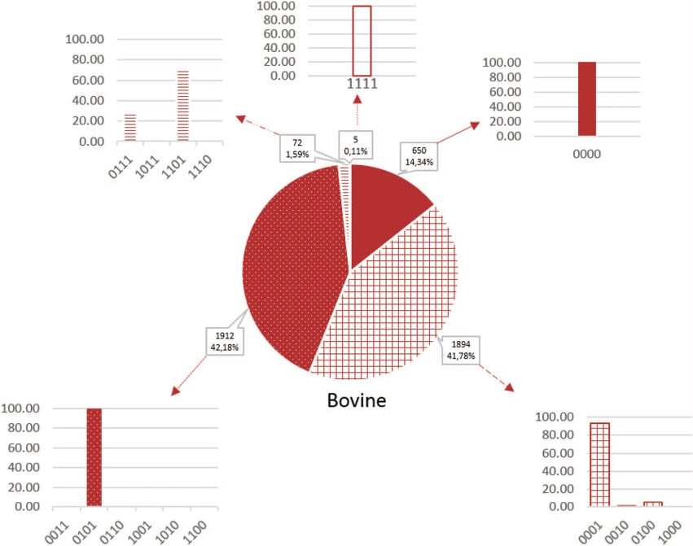
Figure 3 Proportion of microRNAs according to the false-positive codes in cattle. Sequences without a `1’-value are ...
Notes:
Figure 3 Proportion of microRNAs according to the false-positive codes in cattle. Sequences without a `1’-value are more likely to be true microRNAs and those with 4 1-values are less likely to be microRNAs. Plain color, codes without `1’; gridded color, codes with one `1’; dotted color, codes with two `1’, hatched color, codes with three `1’; empty color, codes with four `1’.
Unless provided in the caption above, the following copyright applies to the content of this slide: © The Author(s) 2019. Published by Oxford University Press.This is an Open Access article distributed under the terms of the Creative Commons Attribution License (http://creativecommons.org/licenses/by/4.0/), which permits unrestricted reuse, distribution, and reproduction in any medium, provided the original work is properly cited.

