Slide 1
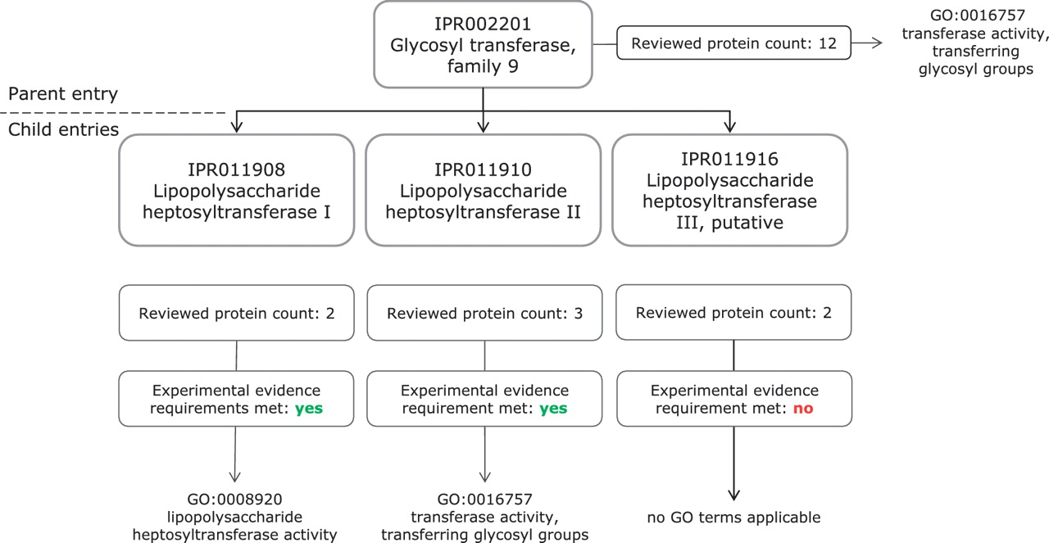
Figure 2. Application of GO molecular function terms to IPR002201 and its child entries. IPR002201 is a more general ...
Notes:
Figure 2. Application of GO molecular function terms to IPR002201 and its child entries. IPR002201 is a more general entry, which encompasses the proteins matched by its three child entries, IPR011908, IPR011910 and IPR011916. The increased specificity of the child entry can be reflected in the GO annotation; IPR011908 has a more specific Molecular Function term than the parent entry IPR002201.
Unless provided in the caption above, the following copyright applies to the content of this slide: © The Author(s) 2012. Published by Oxford University Press.This is an Open Access article distributed under the terms of the Creative Commons Attribution Non-Commercial License (http://creativecommons.org/licenses/by-nc/3.0), which permits unrestricted non-commercial use, distribution, and reproduction in any medium, provided the original work is properly cited.

