Slide 1
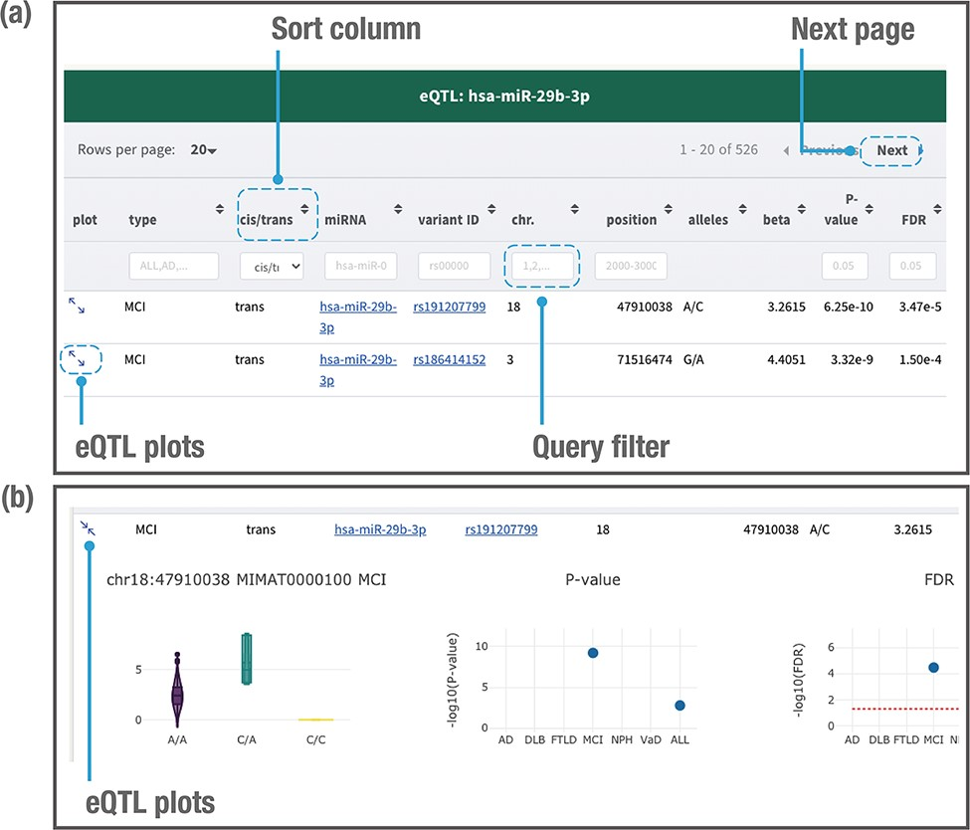
Figure 4. Example of a page displaying search results. The JAMIR-eQTL database returns a table of related miR-eQTL ...
Notes:
Figure 4. Example of a page displaying search results. The JAMIR-eQTL database returns a table of related miR-eQTL records (a). All columns can be sorted, and records without variant alleles and beta values can be filtered. Detailed information on each eQTL plot can be displayed by clicking on the plot column link (b). A vector diagram of a boxplot displaying the association between variant genotypes and miRNA expression is presented, along with P-values and FDRs among the six dementia types and ALL.
Unless provided in the caption above, the following copyright applies to the content of this slide: © The Author(s) 2021. Published by Oxford University Press.This is an Open Access article distributed under the terms of the Creative Commons Attribution License (https://creativecommons.org/licenses/by/4.0/), which permits unrestricted reuse, distribution, and reproduction in any medium, provided the original work is properly cited.

