Slide 1
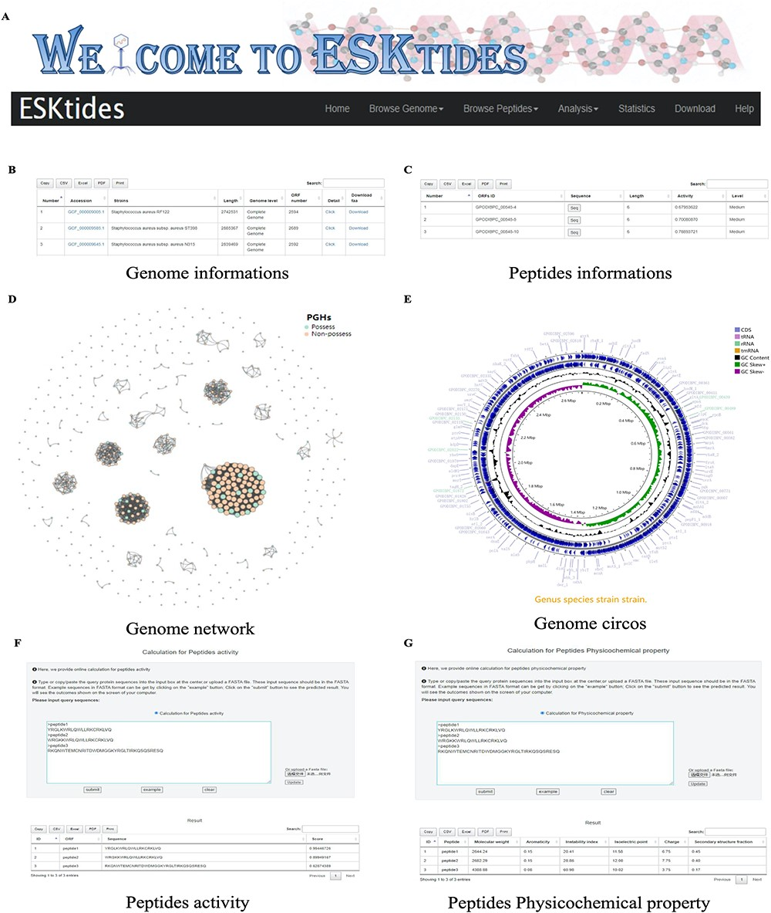
Figure 3. Overview of ESKtides. (A) Main functions of ESKtides, including the ‘Browse Genome’, ‘Browse Peptides’, ...
Notes:
Figure 3. Overview of ESKtides. (A) Main functions of ESKtides, including the ‘Browse Genome’, ‘Browse Peptides’, ‘Analysis’, ‘Statistic’, ‘Download’ and ‘Help’ modules. (B) A table of queried strains or phages information in the ‘Browse Genome’ module. (C) A table of queried ESKAPE-derived peptides information in the ‘Browse Peptides’ module. (D) A graph of queried PGH distribution in the ‘Browse Genome’ module. (E) The annotation circos graph of queried strain. (F) Submit peptides sequences to score the bactericidal activity of the peptide. (G) Calculate peptides sequences physicochemical property.
Unless provided in the caption above, the following copyright applies to the content of this slide: © The Author(s) 2024. Published by Oxford University Press.This is an Open Access article distributed under the terms of the Creative Commons Attribution License (https://creativecommons.org/licenses/by/4.0/), which permits unrestricted reuse, distribution, and reproduction in any medium, provided the original work is properly cited.

