Slide 1
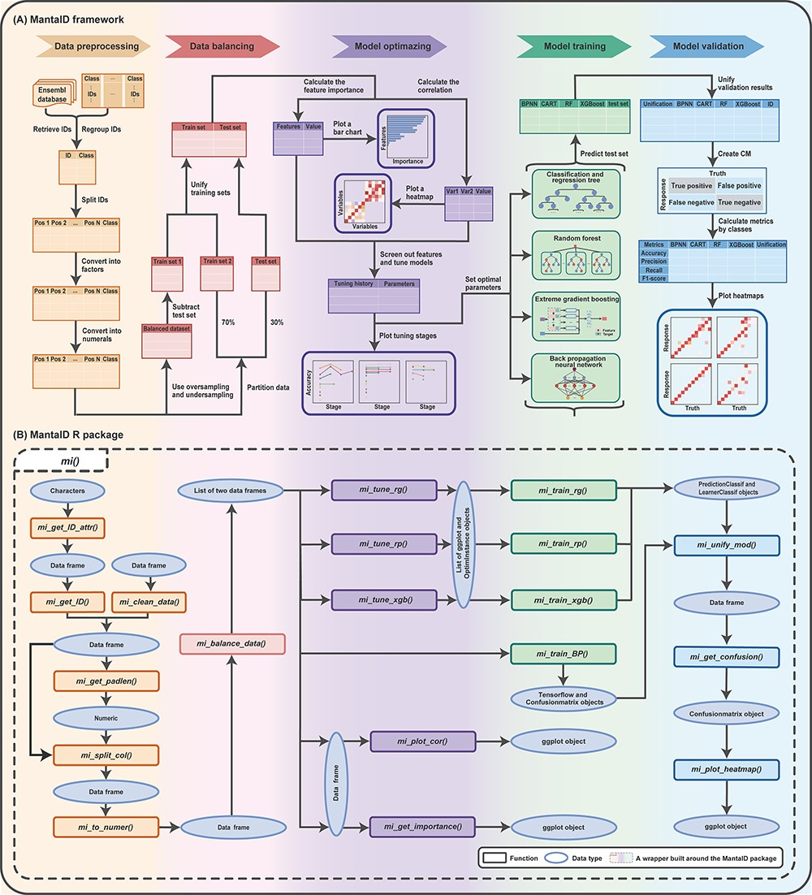
Figure 1. Schematic overview of the MantaID tool. (A) The theoretical framework MantaID. (B) The R package functions of ...
Notes:
Figure 1. Schematic overview of the MantaID tool. (A) The theoretical framework MantaID. (B) The R package functions of MantaID. The wrapper function created by MantaID; a wrapper function ‘mi()’ is created that is used to group the functionalities of MantaID and can be executed to carry out all the steps of the MantaID workflow in a lazy fashion.
Unless provided in the caption above, the following copyright applies to the content of this slide: © The Author(s) 2023. Published by Oxford University Press.This is an Open Access article distributed under the terms of the Creative Commons Attribution License (https://creativecommons.org/licenses/by/4.0/), which permits unrestricted reuse, distribution, and reproduction in any medium, provided the original work is properly cited.

