Slide 1
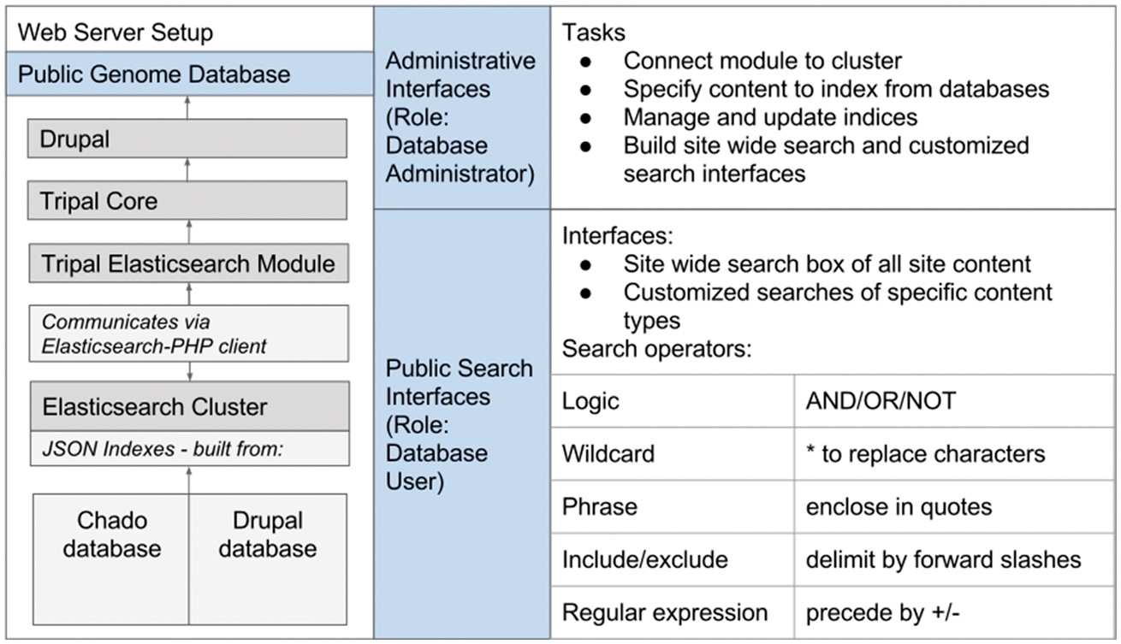
Figure 1. The Tripal Elasticsearch module depends on a number of other software packages. It works within the Drupal ...
Notes:
Figure 1. The Tripal Elasticsearch module depends on a number of other software packages. It works within the Drupal content management system and requires the core Tripal modules. To build indexes and run efficient searchs, it relies on an Elasticsearch cluster, which it communicates with via the Elasticsearch-PHP client. After installation of the software, all functionality can be controlled from web interfaces. The Drupal administrative user can configure and set up site-wide and customized search interfaces. Once those are active, all website users can perform fast, efficient searching with flexible search operators.
Unless provided in the caption above, the following copyright applies to the content of this slide: © The Author(s) 2017. Published by Oxford University Press.This is an Open Access article distributed under the terms of the Creative Commons Attribution License (http://creativecommons.org/licenses/by/4.0/), which permits unrestricted reuse, distribution, and reproduction in any medium, provided the original work is properly cited.

