Slide 1
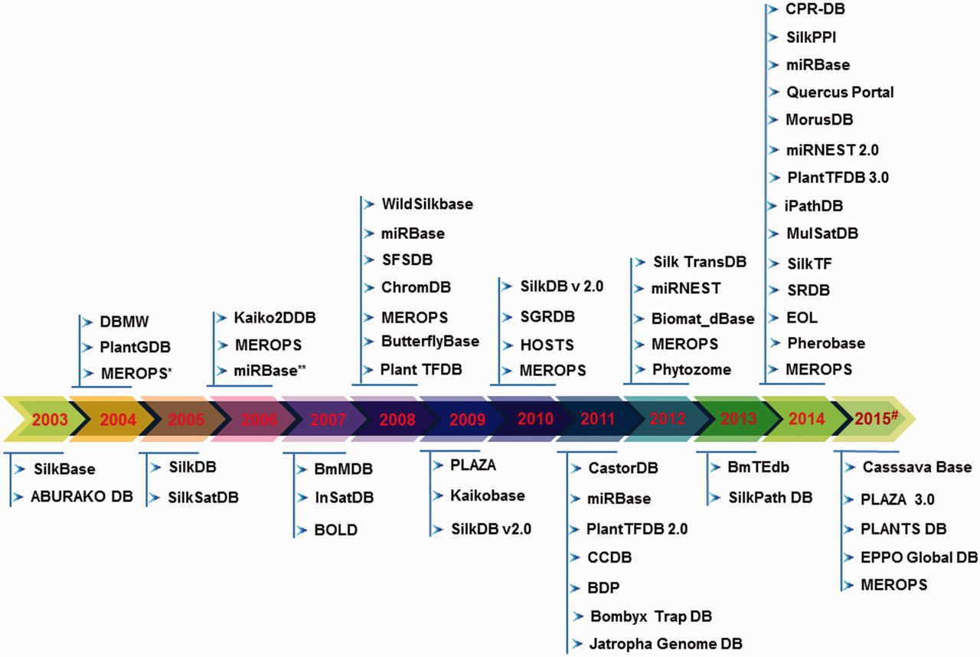
Figure 2. Timeline of the existing seri-databases from the year 2003 to 2015# generated using respective publication in ...
Notes:
Figure 2. Timeline of the existing seri-databases from the year 2003 to 2015# generated using respective publication in the literature and database creation year from websites, where (#) represents 2015-continued year; (*) indicates database first published in 1999 and its updated versions considered from period 2003–2015; (**) indicates the same database with updated information.
Unless provided in the caption above, the following copyright applies to the content of this slide: © The Author(s) 2016. Published by Oxford University Press.This is an Open Access article distributed under the terms of the Creative Commons Attribution License (http://creativecommons.org/licenses/by/4.0/), which permits unrestricted reuse, distribution, and reproduction in any medium, provided the original work is properly cited.

