Slide 1
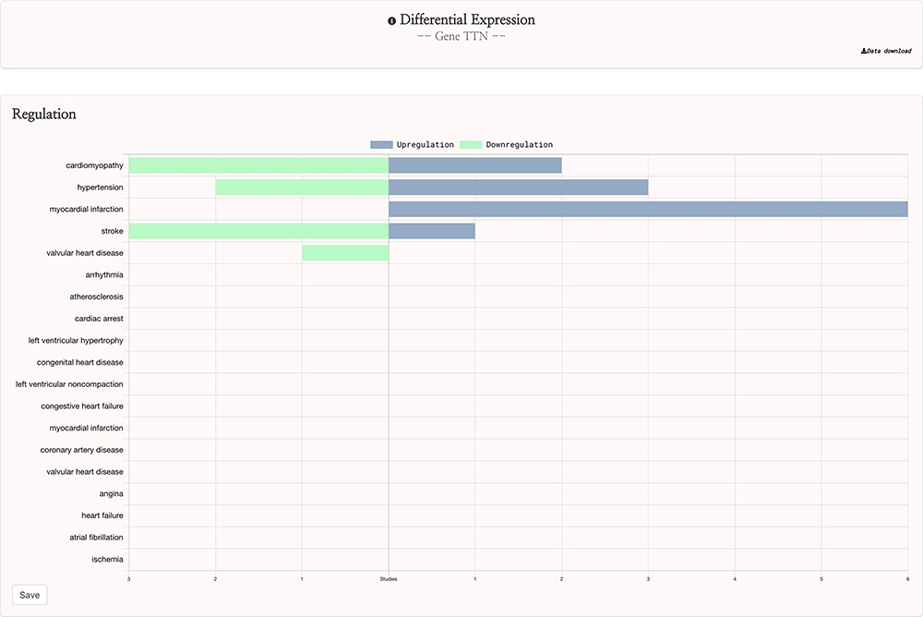
Figure 3. HeartBioPortal2.0’s differential gene expression feature. Users can visually explore the landscape of up- and ...
Notes:
Figure 3. HeartBioPortal2.0’s differential gene expression feature. Users can visually explore the landscape of up- and downregulation of any gene across a variety of CVD-relevant phenotypes from GEO studies that have been further manually curated and harmonized for HeartBioPortal inclusion via a uniform data-processing pipeline (as described in Methods section). In addition, the Data Download button provides actionable metadata such as FDR adjusted P-value, fold change (presented as logFC) and PMID to facilitate exploratory data analyses.
Unless provided in the caption above, the following copyright applies to the content of this slide: © The Author(s) 2020. Published by Oxford University Press.This is an Open Access article distributed under the terms of the Creative Commons Attribution License (http://creativecommons.org/licenses/by/4.0/), which permits unrestricted reuse, distribution, and reproduction in any medium, provided the original work is properly cited.

