Slide 1
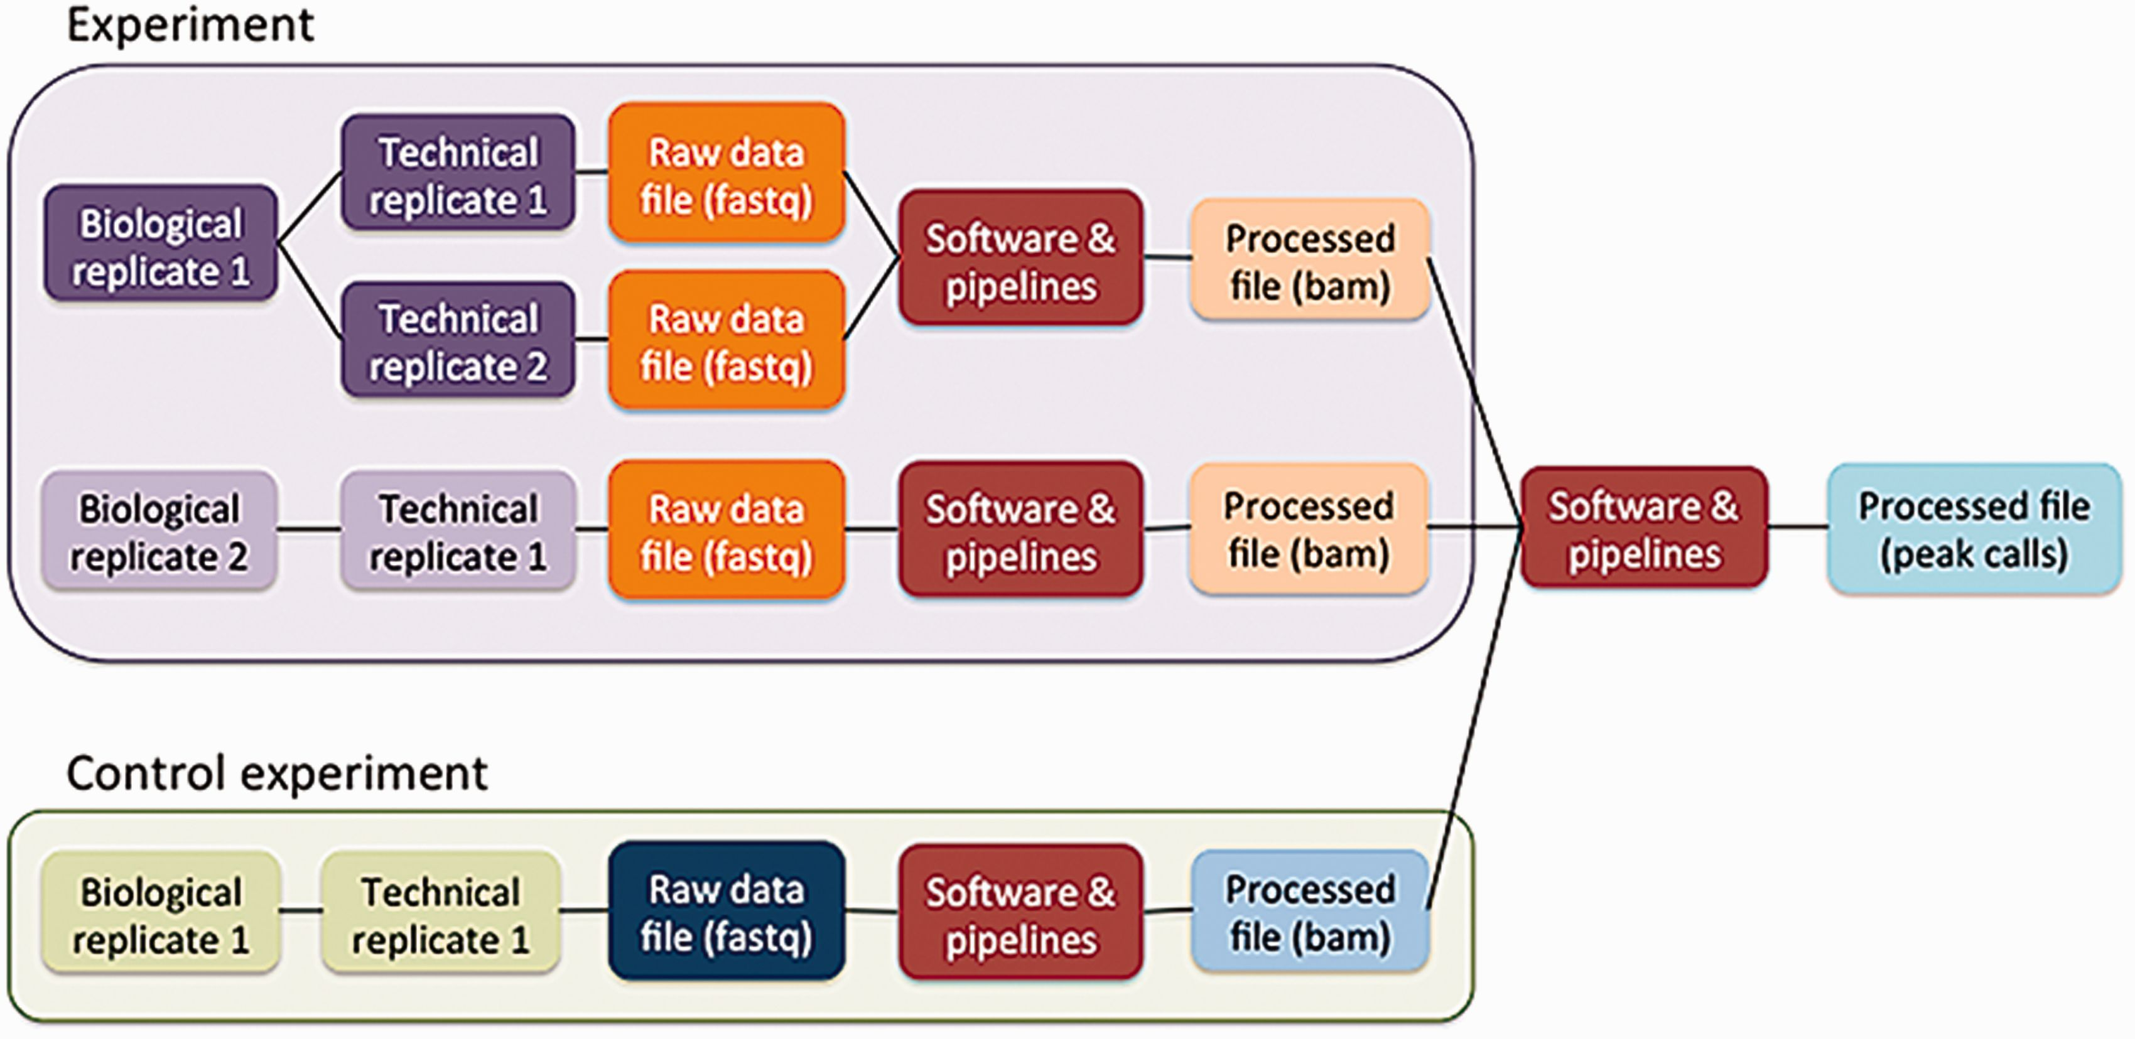
Figure 3 Schematic of the metadata model. The metadata model reflects how researchers perform laboratory and ...
Notes:
Figure 3 Schematic of the metadata model. The metadata model reflects how researchers perform laboratory and computational experiments. A single experiment can contain one or more replicates (see text). These replicates generate raw data files, which are then used in software and data processing pipelines to generate processed data files. Control experiments can be modeled similarly to experiments. Files from multiple experiments can be used as input for a single pipeline run.
Unless provided in the caption above, the following copyright applies to the content of this slide: © The Author(s) 2016. Published by Oxford University Press. This is an Open Access article distributed under the terms of the Creative Commons Attribution License ( http://creativecommons.org/licenses/by/4.0/ ), which permits unrestricted reuse, distribution, and reproduction in any medium, provided the original work is properly cited.

