Slide 1
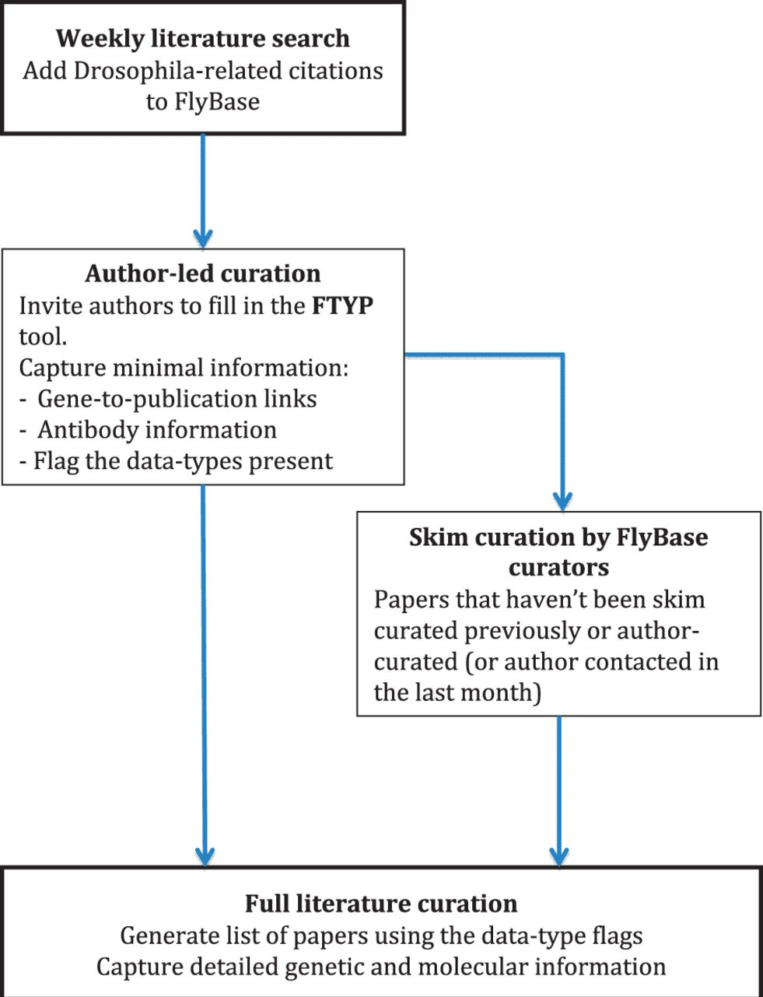
Figure 1 Literature curation pipeline. A weekly PubMed database search identifies new Drosophila-related publications. ...
Notes:
Figure 1 Literature curation pipeline. A weekly PubMed database search identifies new Drosophila-related publications. The citation details for these articles are added to our bibliography, and where possible, the associated PDF is downloaded. The correspondence email for each new article is extracted from the PDF and used to invite the author to use our FTYP tool. Through use of this tool, or a FlyBase curator ‘skim’ curating each article, gene-to-publication links are generated. These are published to our FlyBase website at the first opportunity. Data types found in the article, flagged either by the authors or curators, are then used to generate a priority list for ‘full curation’, where we extract detailed genetic and molecular information.
Unless provided in the caption above, the following copyright applies to the content of this slide: © The Author(s) 2012. Published by Oxford University Press.This is an Open Access article distributed under the terms of the Creative Commons Attribution License (http://creativecommons.org/licenses/by-nc/3.0/), which permits non-commercial reuse, distribution, and reproduction in any medium, provided the original work is properly cited. For commercial re-use, please contact journals.permissions@oup.com.

