Slide 1
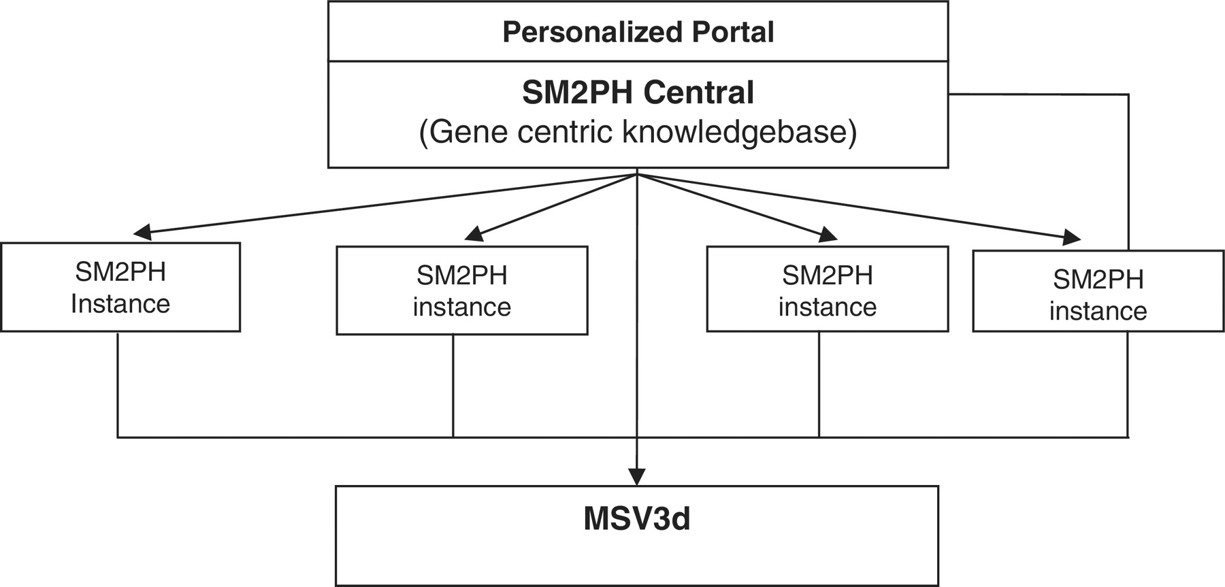
Figure 1 General architecture of SM2PH central. SM2PH Central allows the generation of SM2PH instances (focusing on ...
Notes:
Figure 1 General architecture of SM2PH central. SM2PH Central allows the generation of SM2PH instances (focusing on specific sets of target genes) which can access variant information through the new MSV3d, devoted to human variant data and information.
Unless provided in the caption above, the following copyright applies to the content of this slide: © The Author(s) 2012. Published by Oxford University Press.This is an Open Access article distributed under the terms of the Creative Commons Attribution Non-Commercial License (http://creativecommons.org/licenses/by-nc/3.0), which permits unrestricted non-commercial use, distribution, and reproduction in any medium, provided the original work is properly cited.

