Slide 1
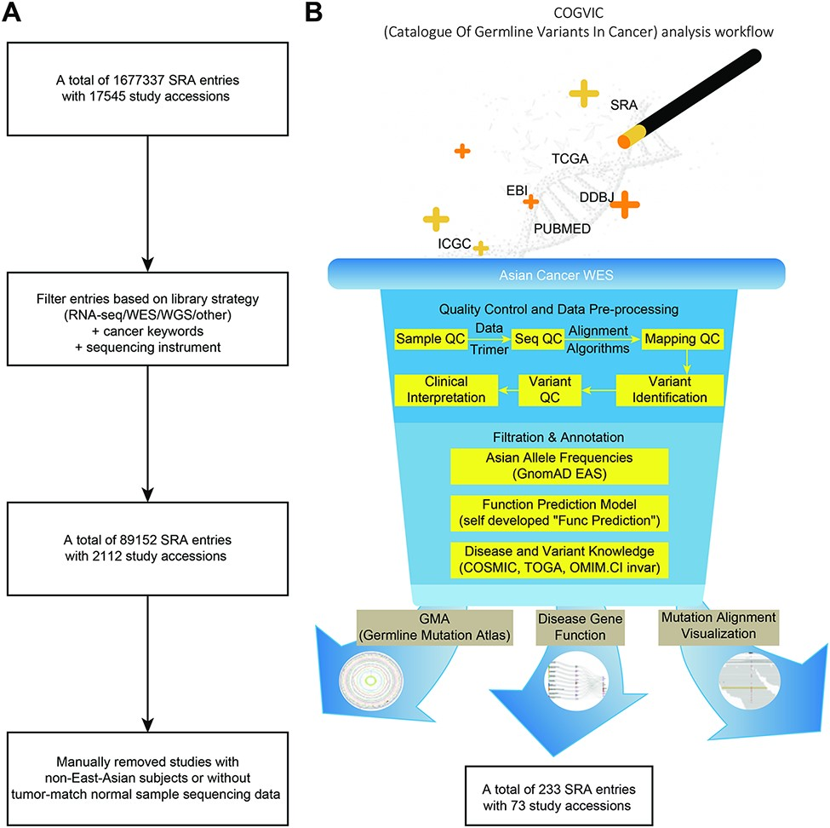
Figure 1. The COGVIC workflow of data selection and germline variant identification. (A) A total of 1 677 337 SRA ...
Notes:
Figure 1. The COGVIC workflow of data selection and germline variant identification. (A) A total of 1 677 337 SRA entries with 17 545 study accessions were filtered out based on the inclusion criteria. (B) The pipeline of the COGVIC germline variant identifier.
Unless provided in the caption above, the following copyright applies to the content of this slide: © The Author(s) 2021. Published by Oxford University Press.This is an Open Access article distributed under the terms of the Creative Commons Attribution License (https://creativecommons.org/licenses/by/4.0/), which permits unrestricted reuse, distribution, and reproduction in any medium, provided the original work is properly cited.

