Slide 1
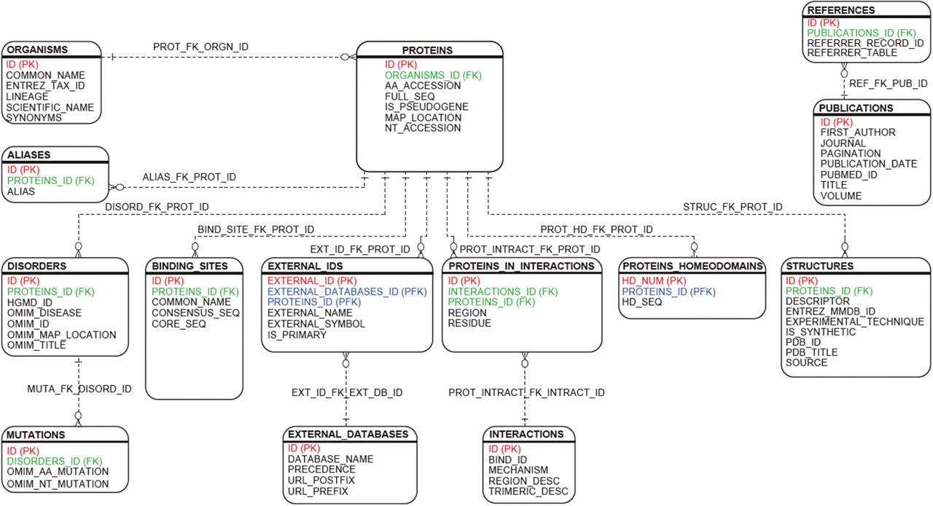
Figure 1. HDR relational framework. The relational design connecting the Homeodomain Resource's 14 primary tables are ...
Notes:
Figure 1. HDR relational framework. The relational design connecting the Homeodomain Resource's 14 primary tables are illustrated in the figure. Primary keys are indicated in red, foreign keys in green and keys characterized as both primary and foreign in blue. The new database design is centered around data found in the ‘Proteins’ table. All proteins are lineage-specific and linked to the ‘Organisms’ table. A single protein may contain one or more homeodomains related to the ‘Proteins_Homeodomains’ table. DNA-binding targets, protein–protein interactions, 3D structures and homeodomains implicated in human disorders are normalized and linked to the ‘Proteins’ table. External annotation from multiple databases are integrated via the ‘External_Ids’ table. Database entries are referenced with their primary citation via the ‘Publications’ table.
Unless provided in the caption above, the following copyright applies to the content of this slide: Published by Oxford University Press 2009.This is Open Access article distributed under the terms of the Creative Commons Attribution Non-Commercial License (http://creativecommons.org/licenses/by-nc/2.0/uk/) which permits unrestricted non-commercial use, distribution, and reproduction in any medium, provided the original work is properly cited.

