Slide 1
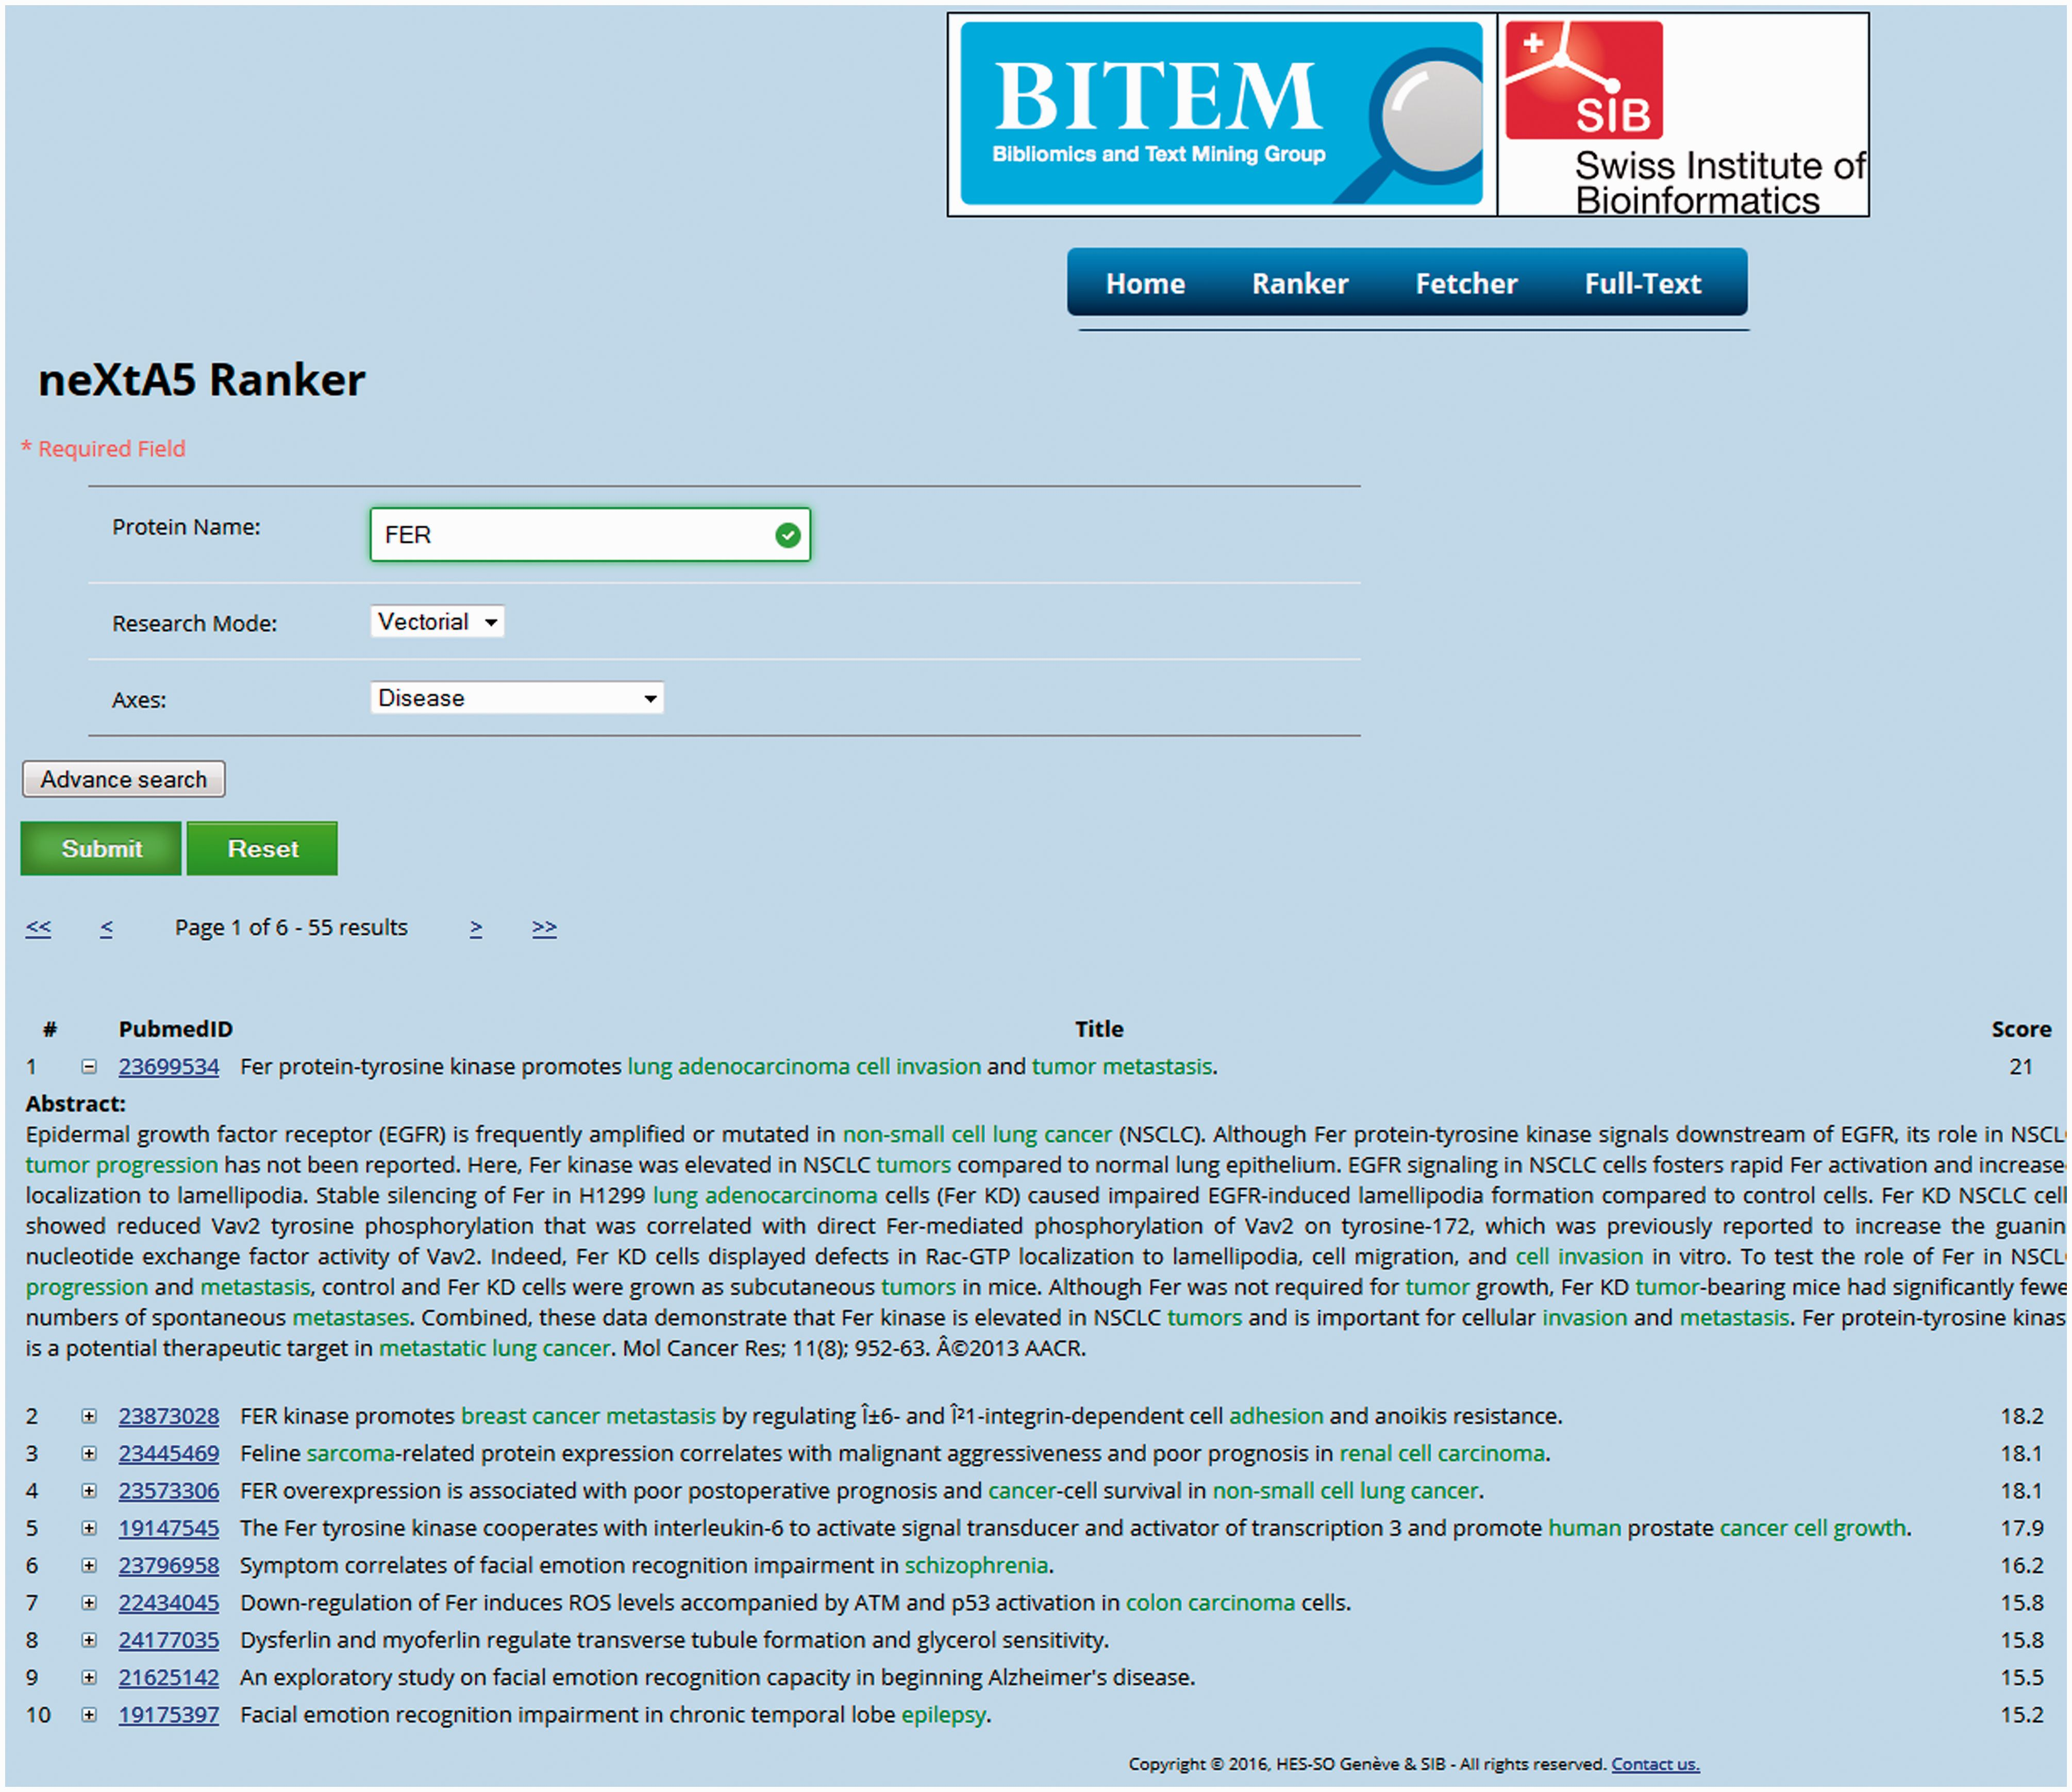
Figure 2. The neXtA ₅ web interface. The query was {FER—vectorial—Diseases}, with 1990 as the lower limit ...
Notes:
Figure 2. The neXtA 5 web interface. The query was {FER—vectorial—Diseases}, with 1990 as the lower limit (the date can be modified in advanced mode) for the publication dates. The output presents the first fifty results ranked over the chosen axis, with the score of the linear combination and the concepts identified in the PMID.
Unless provided in the caption above, the following copyright applies to the content of this slide: © The Author(s) 2016. Published by Oxford University Press. This is an Open Access article distributed under the terms of the Creative Commons Attribution License ( http://creativecommons.org/licenses/by/4.0/ ), which permits unrestricted reuse, distribution, and reproduction in any medium, provided the original work is properly cited.

