Slide 1
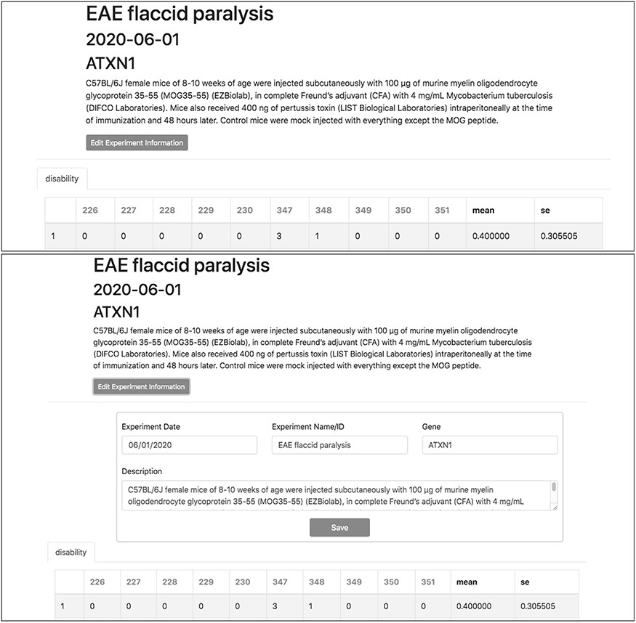
Figure 7. Experiment metadata can be edited by clicking the ‘Edit Experiment Information’ button in the experiment ...
Notes:
Figure 7. Experiment metadata can be edited by clicking the ‘Edit Experiment Information’ button in the experiment interface. ‘Accordian’-like elements, invisible until activated by the user, keep pages uncluttered, avoid time-consuming navigation and provide utility.
Unless provided in the caption above, the following copyright applies to the content of this slide: © The Author(s) 2020. Published by Oxford University Press.This is an Open Access article distributed under the terms of the Creative Commons Attribution License (http://creativecommons.org/licenses/by/4.0/), which permits unrestricted reuse, distribution, and reproduction in any medium, provided the original work is properly cited.

