Slide 1
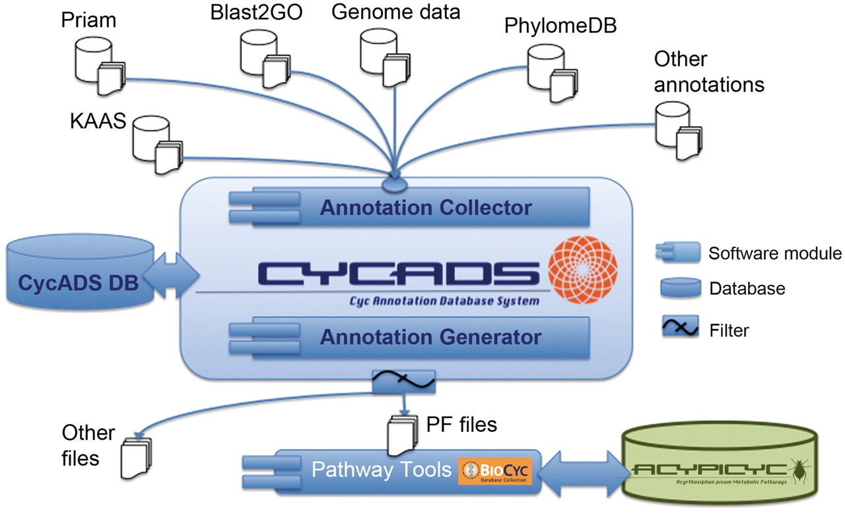
Figure 1. CycADS annotation management system workflow. Genomic information is combined in CycADS with the annotation ...
Notes:
Figure 1. CycADS annotation management system workflow. Genomic information is combined in CycADS with the annotation data obtained using different methods and the collected data are filtered to produce the PathoLogic files (PF files output) that will then be used to generate the BioCyc databases with the Pathway Tools system (PathoLogic module). The annotations can also be extracted for other applications using the filtering system (other files output).
Unless provided in the caption above, the following copyright applies to the content of this slide: © The Author(s) 2011. Published by Oxford University Press.This is Open Access article distributed under the terms of the Creative Commons Attribution Non-Commercial License (http://creativecommons.org/licenses/by-nc/2.5), which permits unrestricted non-commercial use, distribution, and reproduction in any medium, provided the original work is properly cited.

