Slide 1
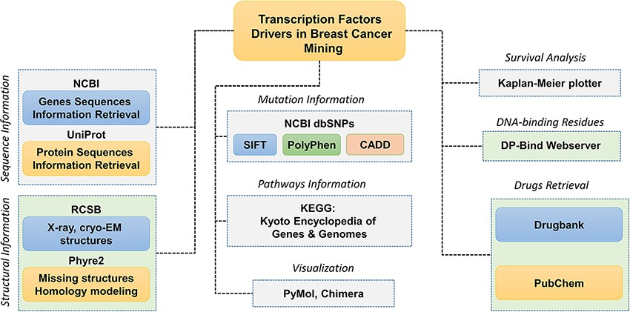
Figure 1. Schematic representation of the database components and data analysis modules used to obtain the specific ...
Notes:
Figure 1. Schematic representation of the database components and data analysis modules used to obtain the specific results. Each tab is tagged, and their respective analyses of webservers or software are also given.
Unless provided in the caption above, the following copyright applies to the content of this slide: © Crown copyright 2021.This Open Access article contains public sector information licensed under the Open Government Licence v3.0 (http://www.nationalarchives.gov.uk/doc/open-government-licence/version/3/).

Slide 2
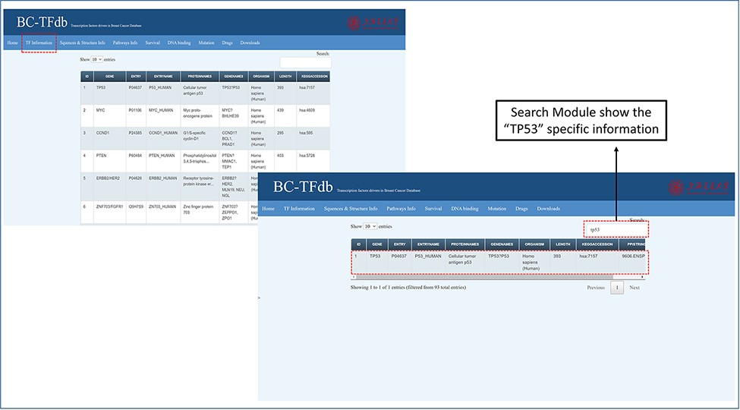
Figure 2. Representative image of the basic information tab showing details about TFs from the dataset of the cohort ...
Notes:
Figure 2. Representative image of the basic information tab showing details about TFs from the dataset of the cohort study. The bottom panel shows the search module implemented in the database to obtain specific information.
Unless provided in the caption above, the following copyright applies to the content of this slide: © Crown copyright 2021.This Open Access article contains public sector information licensed under the Open Government Licence v3.0 (http://www.nationalarchives.gov.uk/doc/open-government-licence/version/3/).

Slide 3
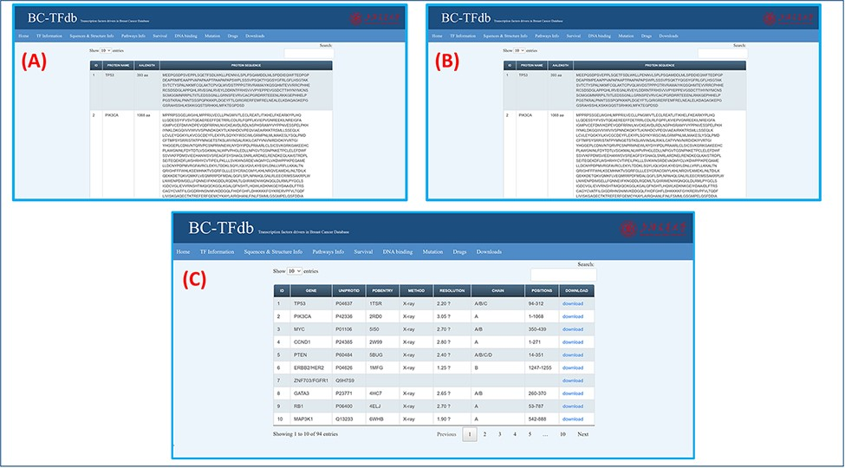
Figure 3. Representation of the Sequence and structural information tab. (A) shows the tutorial image for accessing the ...
Notes:
Figure 3. Representation of the Sequence and structural information tab. (A) shows the tutorial image for accessing the gene sequence information of TFs. (B) shows the tutorial image of accessing the protein sequence information of TFs. (C) shows the tutorial image of accessing the protein structural information of TFs.
Unless provided in the caption above, the following copyright applies to the content of this slide: © Crown copyright 2021.This Open Access article contains public sector information licensed under the Open Government Licence v3.0 (http://www.nationalarchives.gov.uk/doc/open-government-licence/version/3/).

Slide 4
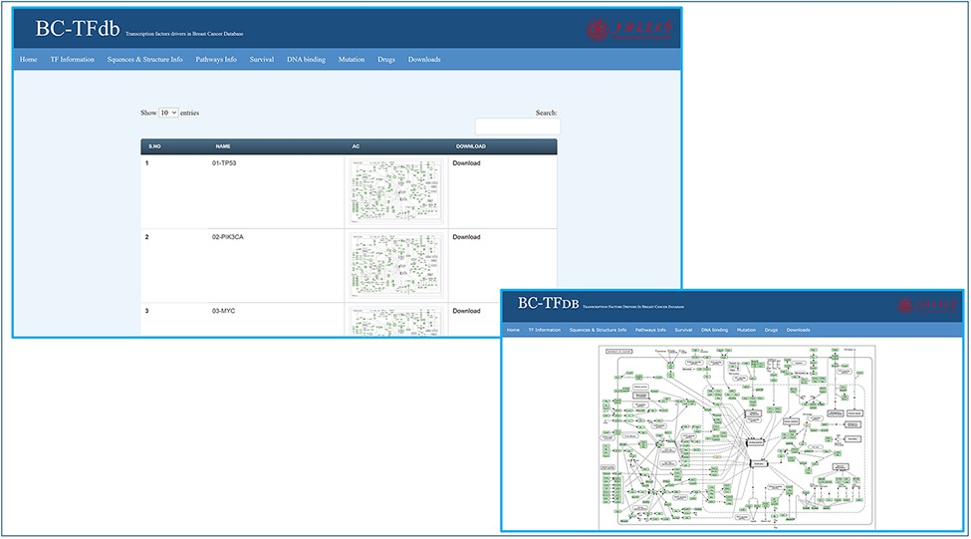
Figure 4. Representative tutorial image of the Pathway information tab upon online access. The bottom panel views a ...
Notes:
Figure 4. Representative tutorial image of the Pathway information tab upon online access. The bottom panel views a sample pathway of TP53.
Unless provided in the caption above, the following copyright applies to the content of this slide: © Crown copyright 2021.This Open Access article contains public sector information licensed under the Open Government Licence v3.0 (http://www.nationalarchives.gov.uk/doc/open-government-licence/version/3/).

Slide 5
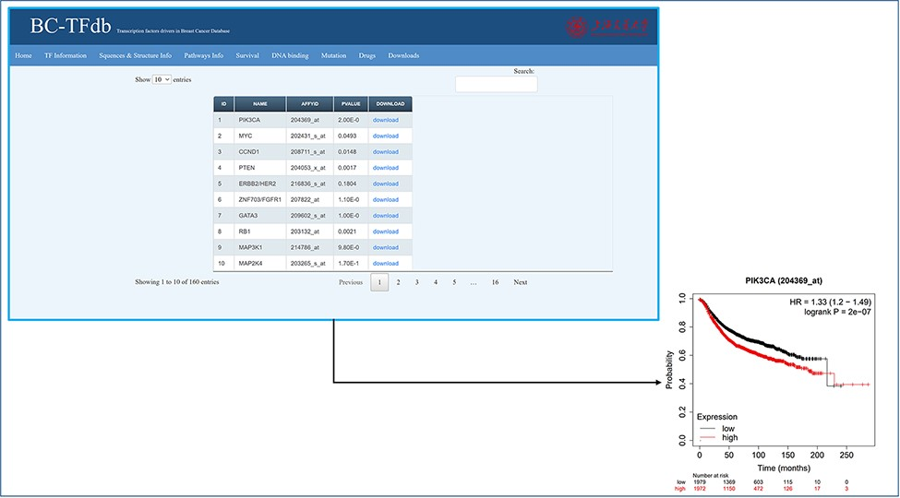
Figure 5. Representative image of the Survival information tab, including a list of all TFs and their downloadable KM ...
Notes:
Figure 5. Representative image of the Survival information tab, including a list of all TFs and their downloadable KM (kaplan-meier plot) plots. The bottom panel shows the sample survival KM plot for PIK3CA.
Unless provided in the caption above, the following copyright applies to the content of this slide: © Crown copyright 2021.This Open Access article contains public sector information licensed under the Open Government Licence v3.0 (http://www.nationalarchives.gov.uk/doc/open-government-licence/version/3/).

Slide 6
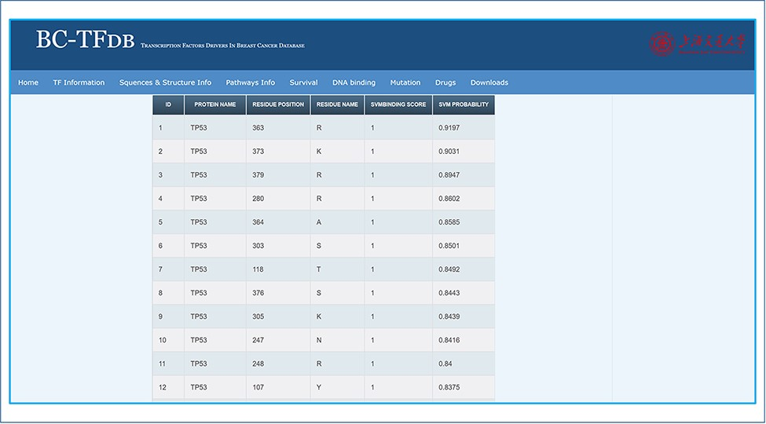
Figure 6. Representative image of the DNA binding tab, including a list of all TFs and listed SVM scores.
Notes:
Figure 6. Representative image of the DNA binding tab, including a list of all TFs and listed SVM scores.
Unless provided in the caption above, the following copyright applies to the content of this slide: © Crown copyright 2021.This Open Access article contains public sector information licensed under the Open Government Licence v3.0 (http://www.nationalarchives.gov.uk/doc/open-government-licence/version/3/).

Slide 7
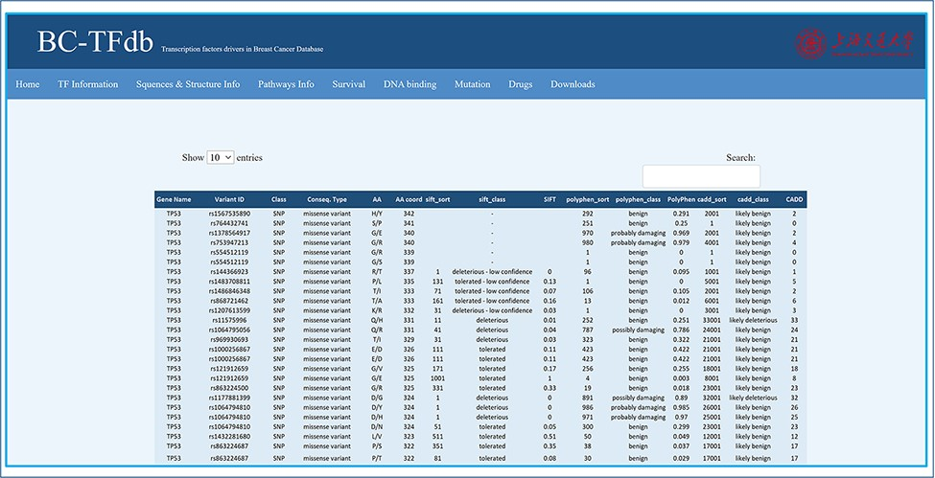
Figure 7. Representative image of the Mutations tab with various headers representing each feature.
Notes:
Figure 7. Representative image of the Mutations tab with various headers representing each feature.
Unless provided in the caption above, the following copyright applies to the content of this slide: © Crown copyright 2021.This Open Access article contains public sector information licensed under the Open Government Licence v3.0 (http://www.nationalarchives.gov.uk/doc/open-government-licence/version/3/).

Slide 8
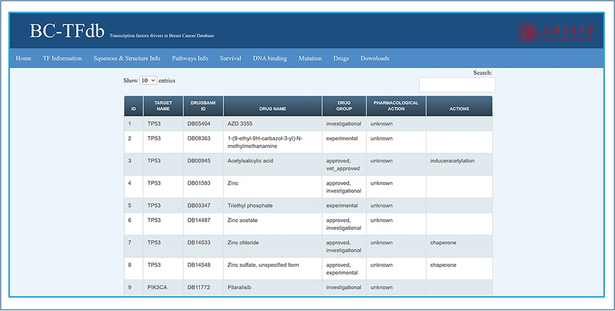
Figure 8. Representative image of the Drugs tab with various headers representing each feature.
Notes:
Figure 8. Representative image of the Drugs tab with various headers representing each feature.
Unless provided in the caption above, the following copyright applies to the content of this slide: © Crown copyright 2021.This Open Access article contains public sector information licensed under the Open Government Licence v3.0 (http://www.nationalarchives.gov.uk/doc/open-government-licence/version/3/).

Slide 9
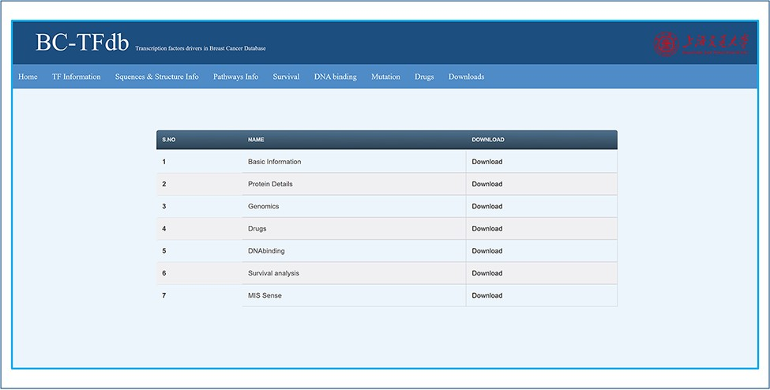
Figure 9. Representative image of the Downloads tab that contains all the files for downloads.
Notes:
Figure 9. Representative image of the Downloads tab that contains all the files for downloads.
Unless provided in the caption above, the following copyright applies to the content of this slide: © Crown copyright 2021.This Open Access article contains public sector information licensed under the Open Government Licence v3.0 (http://www.nationalarchives.gov.uk/doc/open-government-licence/version/3/).

