Slide 1
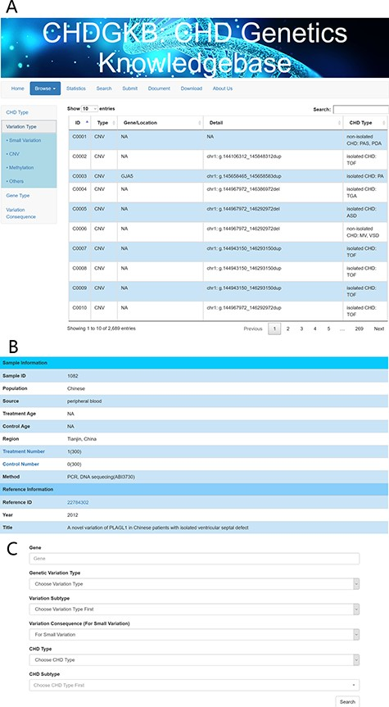
Figure 3 An example of the search interface with CHD subtype and precise query. Detailed information about the genetic ...
Notes:
Figure 3 An example of the search interface with CHD subtype and precise query. Detailed information about the genetic variations can be found in the NS-CHD database. [The search interfaces are depicted in Figure 3A, with links to the original publications (Figure 3B). Figure 3C show the interface for search results using key words, e.g. variations with GATA4].
Unless provided in the caption above, the following copyright applies to the content of this slide: © The Author(s) 2020. Published by Oxford University Press.This is an Open Access article distributed under the terms of the Creative Commons Attribution License (http://creativecommons.org/licenses/by/4.0/), which permits unrestricted reuse, distribution, and reproduction in any medium, provided the original work is properly cited.

