Slide 1
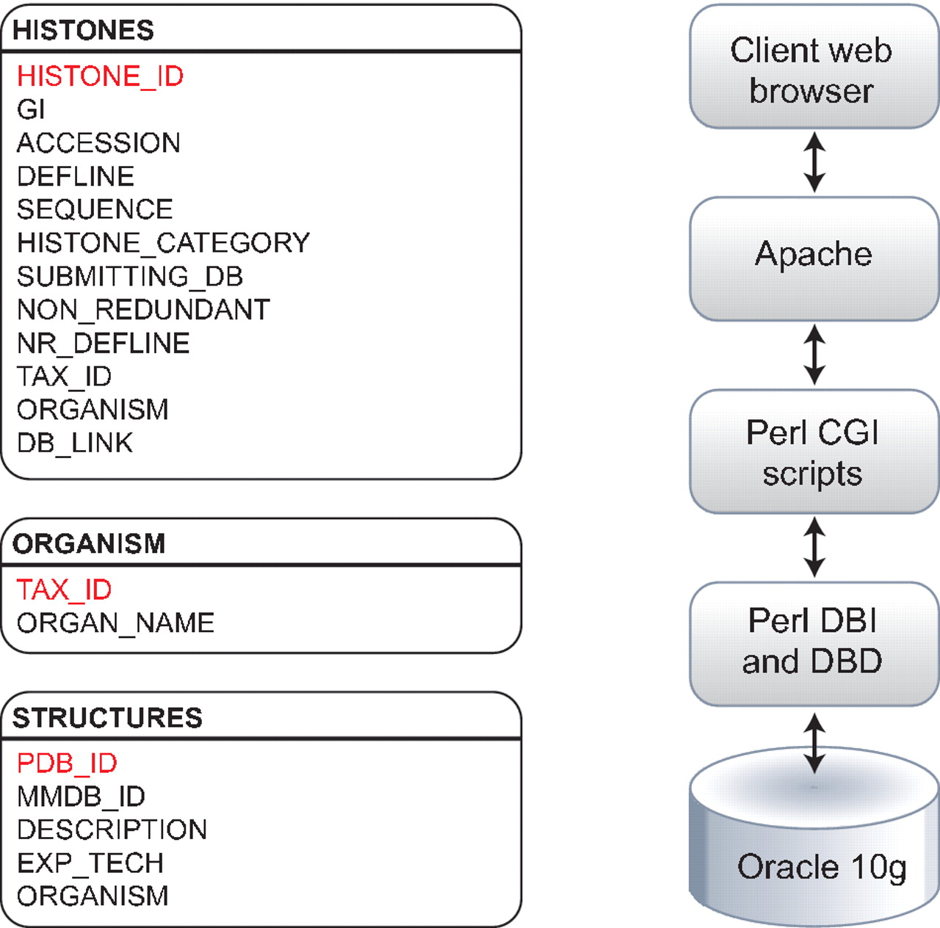
Figure 1. Histone Database data model. The Histone Database stores selected manually curated information from GenBank ...
Notes:
Figure 1. Histone Database data model. The Histone Database stores selected manually curated information from GenBank records. The information stored as part of each record includes the GenBank unique identifier (GI), accession number, definition line, sequence string, histone class, database source, NCBI taxonomic identifier and organism name. The database front-end is written in Perl, the data is stored in an Oracle 10 g relational database, and data is retrieved using Perl DBI and DBD libraries.
Unless provided in the caption above, the following copyright applies to the content of this slide: © The Author(s) 2011. Published by Oxford University Press on behalf of the National Institutes of Health.This is an Open Access article distributed under the terms of the Creative Commons Attribution Non-Commercial License (http://creativecommons.org/licenses/by-nc/3.0), which permits unrestricted non-commercial use, distribution, and reproduction in any medium, provided the original work is properly cited.

