Slide 1
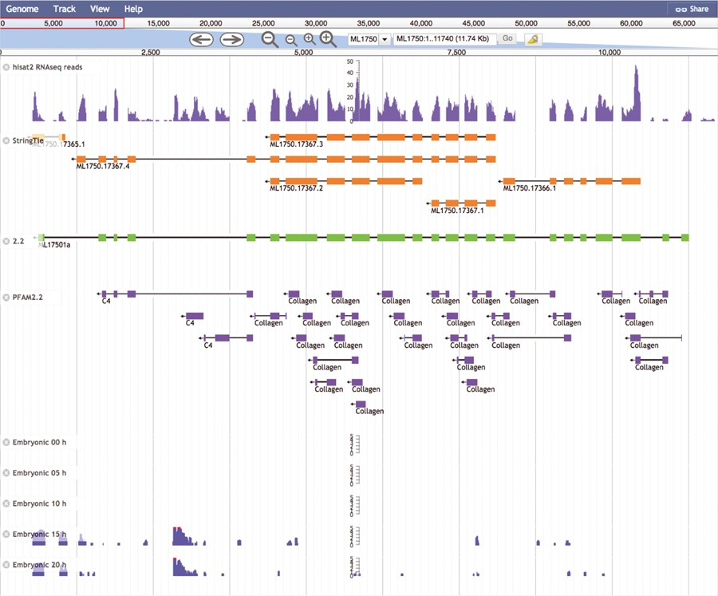
Figure 5 The Mnemiopsis Genome Browser displaying genomic scaffold ML1750. Zooming in on ML17501a and displaying the ...
Notes:
Figure 5 The Mnemiopsis Genome Browser displaying genomic scaffold ML1750. Zooming in on ML17501a and displaying the RNA-seq data from the Embryonic Developmental Time series track at 5-h increments (0, 5, 10, 15 and 20) indicates heightened expression at Hours 15 and 20 relative to earlier developmental time points. Note that the expression scales centered on the embryonic time series tracks are logarithmic. Expression values greater than 100 are truncated and colored red while all other expression values remain blue. The first two tracks above represent RNA-seq data (SRR1971491) derived from Mnemiopsis embryos that were aligned using HISAT2 and assembled into transcripts using StringTie. Also represented is the PFAM2.2 track displaying many collagen protein domains scattered across the entire length of the ML17501a gene.
Unless provided in the caption above, the following copyright applies to the content of this slide: Published by Oxford University Press 2020.This work is written by US Government employees and is in the public domain in the US.

