Slide 1
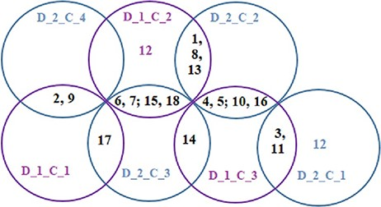
Figure 10. Venn diagrams showing common disease classes between protein and metabolite biomarker-based clusters; 3 ...
Notes:
Figure 10. Venn diagrams showing common disease classes between protein and metabolite biomarker-based clusters; 3 magenta circles are the Clusters 1, 2 and 3 of Figure 8 and 4 green circles are the Clusters 1, 2, 3 and 4 of Figure 9.
Unless provided in the caption above, the following copyright applies to the content of this slide: © The Author(s) 2021. Published by Oxford University Press.This is an Open Access article distributed under the terms of the Creative Commons Attribution License (http://creativecommons.org/licenses/by/4.0/), which permits unrestricted reuse, distribution, and reproduction in any medium, provided the original work is properly cited.

