Slide 1
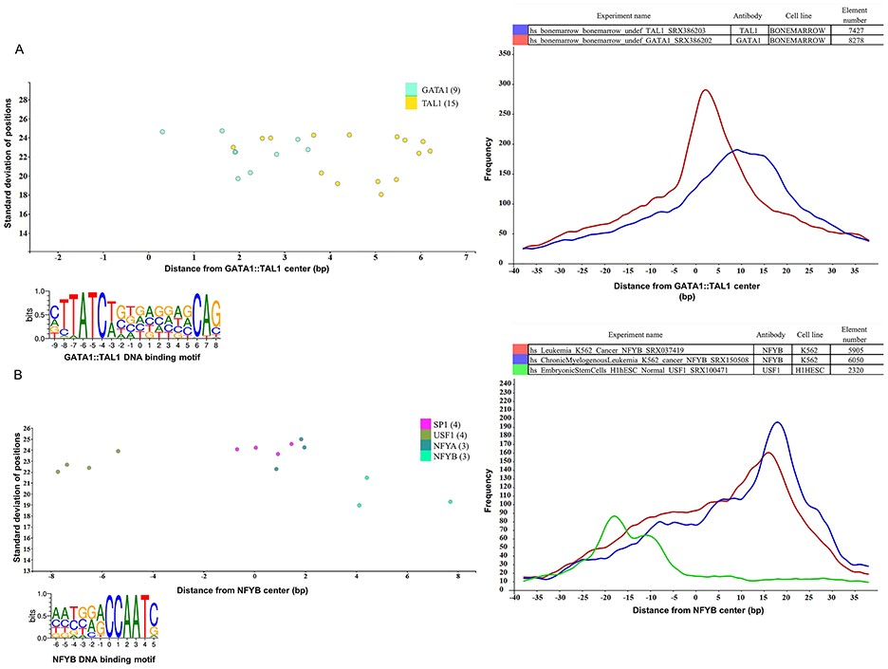
Figure 4 Binding sites based analysis of topological arrangements of TF–DNA complexes as visualized in MotifView and ...
Notes:
Figure 4 Binding sites based analysis of topological arrangements of TF–DNA complexes as visualized in MotifView and PairShiftView. The plots show the preferred positions of different proteins on (A) GATA1::TAL1 binding sites and on (B) NFYB binding sites. The scatterplot follows the same logic as shown on Figure 3. The figures derive from ChIPSummitDB, although the scatters were filtered to show only the presented factors. GATA1::TAL1: http://summit.med.unideb.hu/summitdb/motif_view.php?maxid=2000&minid=1&mnelem=1000&mxelem=120000&motive=GATA1%3A%3ATAL1 NFYB: http://summit.med.unideb.hu/summitdb/motif_view.php?maxid=2000&minid=1&mnelem=2000&mxelem=120000&motive=NFYB. The histograms (at right) show the distribution of the summits relative to the midpoint (motif centers). The horizontal axis shows the distance from motif center, measured in base pairs. The vertical axis displays the distance frequency of summits at the given positions. Each ChIP-seq experiment is represented by a frequency curve (A) GATA1:TAL1: blue—SRX386203, red—SRX386202; (B) NFYB: red—SRX037419, blue—SRX150508, and green—SRX100471, which are smoothed with a rolling mean with a 5 bp window. Element numbers in the tables indicate the number of peak regions obtained in a ChIP-seq experiment, which overlap with a particular consensus motif binding site set. Figures are adapted from ChIPSummitDB website: GATA1::TAL1: http://summit.med.unideb.hu/summitdb/paired_shift_view.php?exp1=218&exp2=220&exp3=undefined&motive=GATA1::TAL1&motifid=89&limit=40&low_limit=-40&formminid=1&formmaxid=2000&mnelem=500&formmaxelem=120000 NFYB: http://summit.med.unideb.hu/summitdb/paired_shift_view.php?exp1=2301&exp2=761&exp3=1597&motive=NFYB&motifid=175&limit=40&low_limit=-40&mnelem=2000.
Unless provided in the caption above, the following copyright applies to the content of this slide: © The Author(s) 2020. Published by Oxford University Press.This is an Open Access article distributed under the terms of the Creative Commons Attribution License (http://creativecommons.org/licenses/by/4.0/), which permits unrestricted reuse, distribution, and reproduction in any medium, provided the original work is properly cited.

