Slide 1
Figure 1. Descriptive information is included in the Overview section of protein pages in the SGD.
Notes:
Figure 1. Descriptive information is included in the Overview section of protein pages in the SGD.
Unless provided in the caption above, the following copyright applies to the content of this slide: © The Author(s) 2017. Published by Oxford University Press.This is an Open Access article distributed under the terms of the Creative Commons Attribution License (http://creativecommons.org/licenses/by/4.0/), which permits unrestricted reuse, distribution, and reproduction in any medium, provided the original work is properly cited.

Slide 2
Figure 2. Integration of PTM information in the SGD is a multi-step process involving the identification of relevant ...
Notes:
Figure 2. Integration of PTM information in the SGD is a multi-step process involving the identification of relevant papers, expert curation of PTM studies, and the visualization and display of PTM data.
Unless provided in the caption above, the following copyright applies to the content of this slide: © The Author(s) 2017. Published by Oxford University Press.This is an Open Access article distributed under the terms of the Creative Commons Attribution License (http://creativecommons.org/licenses/by/4.0/), which permits unrestricted reuse, distribution, and reproduction in any medium, provided the original work is properly cited.

Slide 3
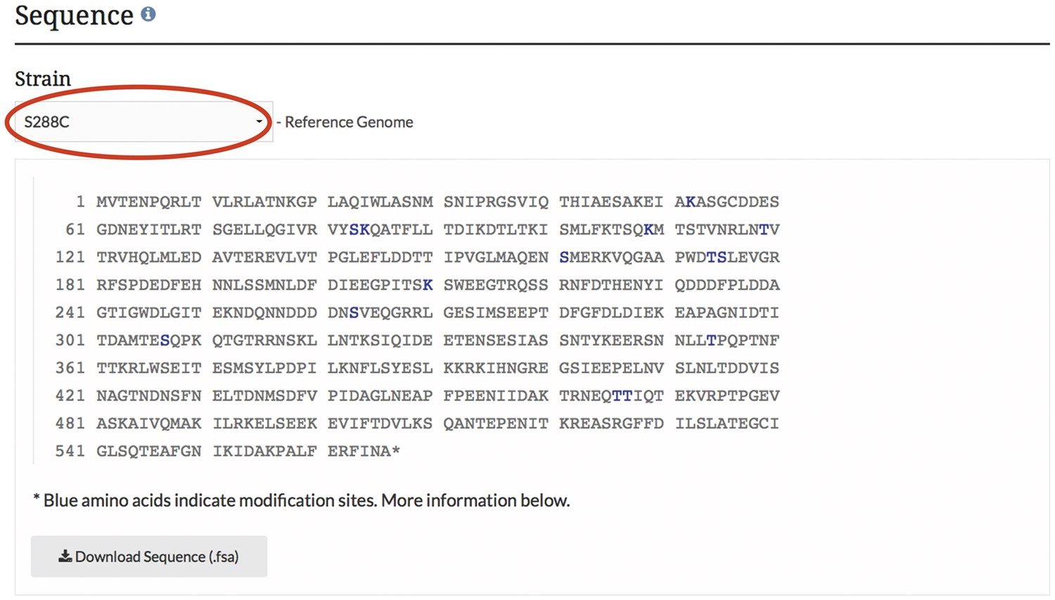
Figure 3. PTM information is integrated into the SGD and displayed on protein pages as highlighted residues overlaid on ...
Notes:
Figure 3. PTM information is integrated into the SGD and displayed on protein pages as highlighted residues overlaid on the protein sequence. The example shown here is from the MCD1 protein page.
Unless provided in the caption above, the following copyright applies to the content of this slide: © The Author(s) 2017. Published by Oxford University Press.This is an Open Access article distributed under the terms of the Creative Commons Attribution License (http://creativecommons.org/licenses/by/4.0/), which permits unrestricted reuse, distribution, and reproduction in any medium, provided the original work is properly cited.

Slide 4
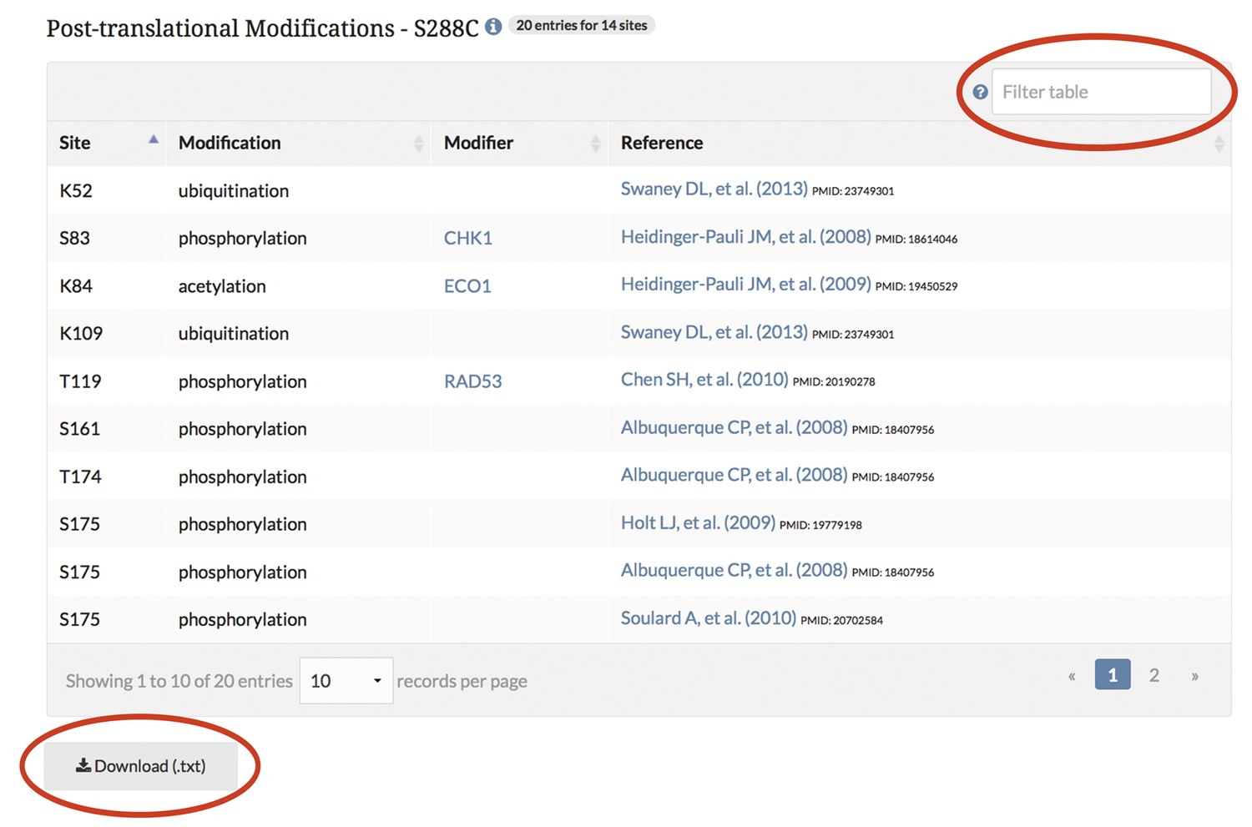
Figure 4. PTM information is integrated into the SGD and displayed on protein pages in a searchable, sortable table. ...
Notes:
Figure 4. PTM information is integrated into the SGD and displayed on protein pages in a searchable, sortable table. The example shown here is from the MCD1 protein page.
Unless provided in the caption above, the following copyright applies to the content of this slide: © The Author(s) 2017. Published by Oxford University Press.This is an Open Access article distributed under the terms of the Creative Commons Attribution License (http://creativecommons.org/licenses/by/4.0/), which permits unrestricted reuse, distribution, and reproduction in any medium, provided the original work is properly cited.

Slide 5
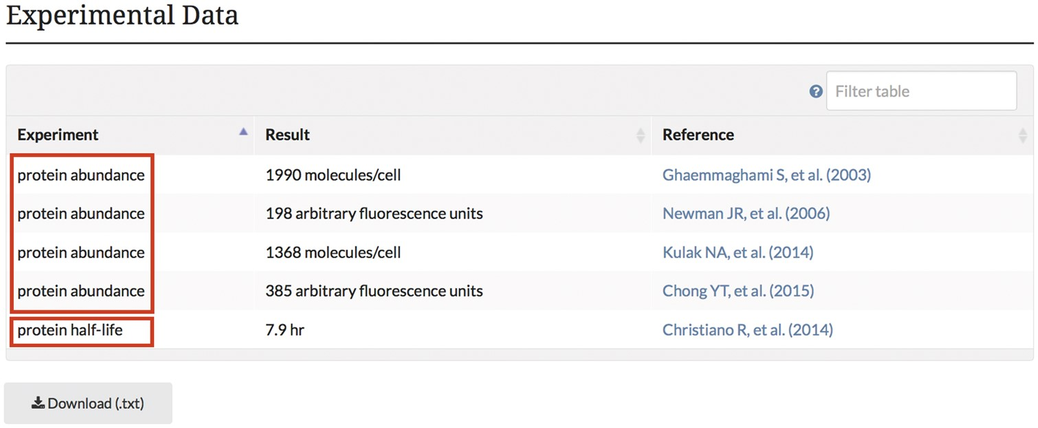
Figure 5. Experimental abundance and half-life data obtained from high-throughput proteome studies are integrated into ...
Notes:
Figure 5. Experimental abundance and half-life data obtained from high-throughput proteome studies are integrated into the SGD and displayed on protein pages in a searchable, sortable table. The example shown here is from the STH1 protein page.
Unless provided in the caption above, the following copyright applies to the content of this slide: © The Author(s) 2017. Published by Oxford University Press.This is an Open Access article distributed under the terms of the Creative Commons Attribution License (http://creativecommons.org/licenses/by/4.0/), which permits unrestricted reuse, distribution, and reproduction in any medium, provided the original work is properly cited.

Slide 6
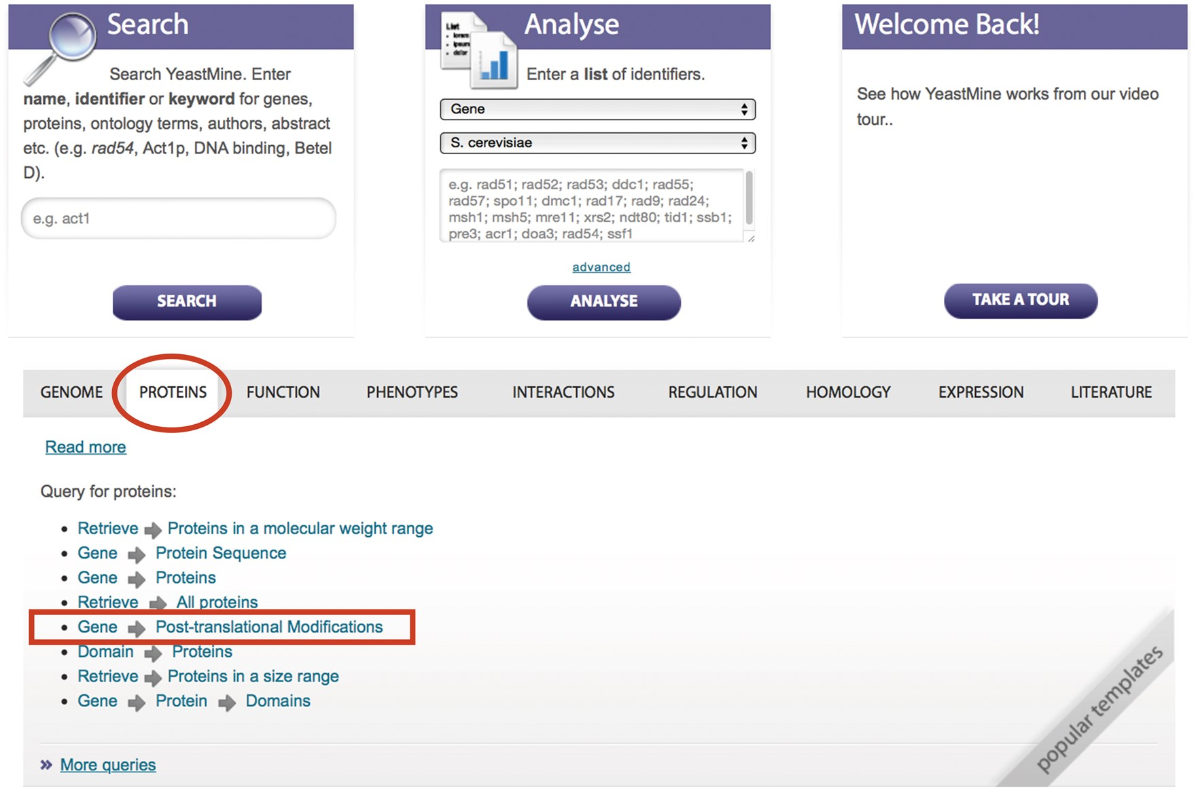
Figure 6. PTM information can be queried and retrieved using the ‘Gene → PTM’ template in YeastMine ...
Notes:
Figure 6. PTM information can be queried and retrieved using the ‘Gene → PTM’ template in YeastMine (yeastmine.yeastgenome.org).
Unless provided in the caption above, the following copyright applies to the content of this slide: © The Author(s) 2017. Published by Oxford University Press.This is an Open Access article distributed under the terms of the Creative Commons Attribution License (http://creativecommons.org/licenses/by/4.0/), which permits unrestricted reuse, distribution, and reproduction in any medium, provided the original work is properly cited.

