Slide 1
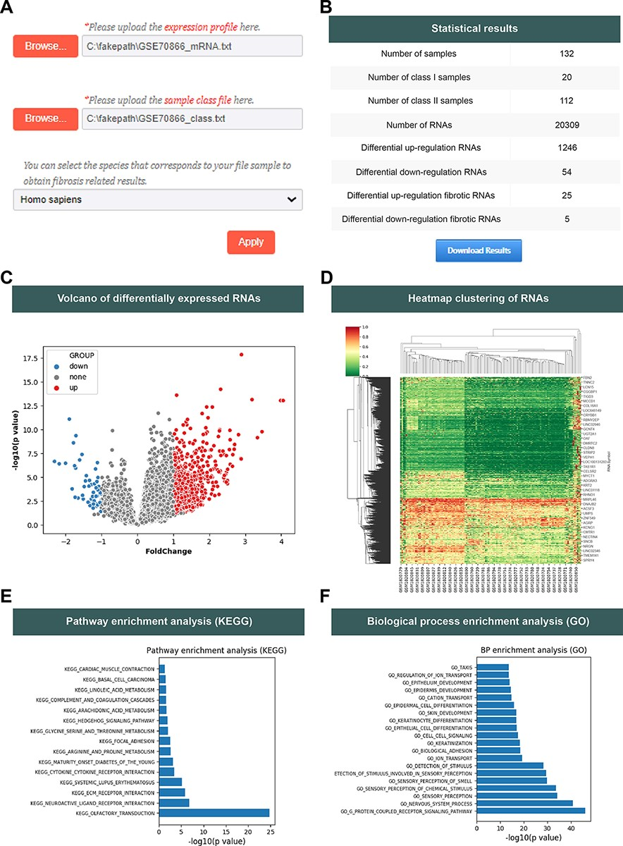
Figure 2. The analysis function of the FDRdb. (A) The upload interface on the ‘Analysis’ page. (B) The statistics of ...
Notes:
Figure 2. The analysis function of the FDRdb. (A) The upload interface on the ‘Analysis’ page. (B) The statistics of analysis results. (C) The volcano plot of differentially expressed RNAs. (D) The heatmap clustering of differentially expressed RNAs. A statistical bar chart of pathway enrichment analysis in KEGG (E) and analysis of biological process enrichment in GO (F).
Unless provided in the caption above, the following copyright applies to the content of this slide: © The Author(s) 2022. Published by Oxford University Press.This is an Open Access article distributed under the terms of the Creative Commons Attribution-NonCommercial License (https://creativecommons.org/licenses/by-nc/4.0/), which permits non-commercial re-use, distribution, and reproduction in any medium, provided the original work is properly cited. For commercial re-use, please contact journals.permissions@oup.com

