Slide 1
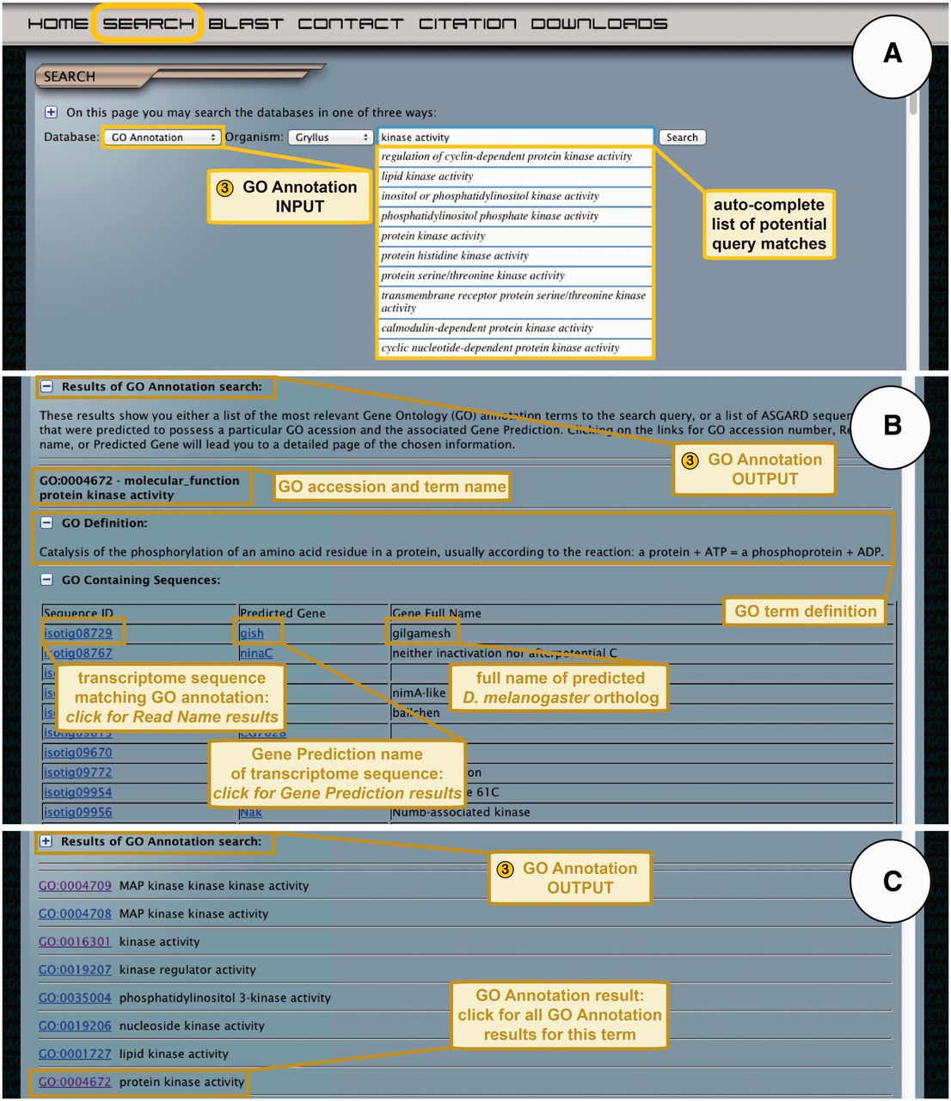
Figure 5 ASGARD GO Annotation search. (A) The input user interface allows users to choose an organism of interest and ...
Notes:
Figure 5 ASGARD GO Annotation search. (A) The input user interface allows users to choose an organism of interest and enter GO term queries, where they are assisted by an auto-completed list of suggested matching GO terms. In this example, a user searching for G. bimaculatus protein kinases enters the query ‘kinase activity’ into the search box. (B) The output of GO annotation searches based on user-defined queries yields a list of transcriptome sequences that map to the chosen GO term, with links to the read name searches for each sequence. This example shows results obtained by using ‘kinase activity’ as a query. (C) The output of GO annotation searches based on selection of auto-completion menu items yields a list of matching GO terms assigned to transcriptome sequences from the chosen organism, with links to all transcriptome sequences assigned to a given GO term. The example shows results obtained by selecting the GO term ‘protein kinase activity’ from the drop-down auto-completion suggestions shown in (A).
Unless provided in the caption above, the following copyright applies to the content of this slide: © The Author(s) 2012. Published by Oxford University Press.This is an Open Access article distributed under the terms of the Creative Commons Attribution License (http://creativecommons.org/licenses/by-nc/3.0/), which permits non-commercial reuse, distribution, and reproduction in any medium, provided the original work is properly cited. For commercial re-use, please contact journals.permissions@oup.com.

