Slide 1
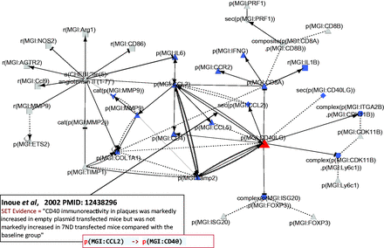
Figure 4. Part of the network showing CD40LG and its interactions with other hub nodes. Biological entities or nodes. ...
Notes:
Figure 4. Part of the network showing CD40LG and its interactions with other hub nodes. Biological entities or nodes. CD40LG is indicated in red, and the nodes that are regulated by CD40LG are indicated in blue. An example of evidence extracted from Inoue et al . ( 53 ) (PMID: 12438296) with the semi-automated extraction workflow and the associated BEL statement are given in the two boxes on the bottom left of the figure. Square, RNA abundance; triangle, protein abundance; V shape, protein activity; hexagon, complex; diamond, secretion. (B) Relationships or edges. Lines with dark arrows indicate positive causal relationships; lines with dark Ts indicate negative causal relationships; black sine waves indicate correlative relationships and black dotted lines indicate non-causal relationships.
Unless provided in the caption above, the following copyright applies to the content of this slide: © The Author(s) 2015. Published by Oxford University Press.This is an Open Access article distributed under the terms of the Creative Commons Attribution License (http://creativecommons.org/licenses/by/4.0/), which permits unrestricted reuse, distribution, and reproduction in any medium, provided the original work is properly cited.

