Slide 1
Figure 1 Our classification framework. The irrelevant class is partitioned into k (k = 8) subsets using K means ...
Notes:
Figure 1 Our classification framework. The irrelevant class is partitioned into k (k = 8) subsets using K means clustering. Each such subset along with the relevant set are used to train eight base-classifiers. The results obtained from the base-classifiers are then used by the meta-classifier to assign the final class label to each document.
Unless provided in the caption above, the following copyright applies to the content of this slide: © The Author(s) 2020. Published by Oxford University Press.This is an Open Access article distributed under the terms of the Creative Commons Attribution License (http://creativecommons.org/licenses/by/4.0/), which permits unrestricted reuse, distribution, and reproduction in any medium, provided the original work is properly cited.

Slide 2
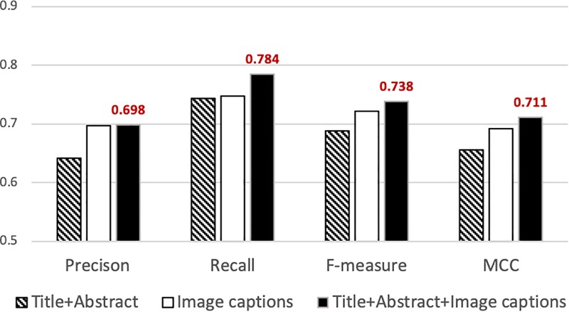
Figure 2 Precision, recall, f-measure and MCC attained by our classifier using different sets of features. The best ...
Notes:
Figure 2 Precision, recall, f-measure and MCC attained by our classifier using different sets of features. The best performance is attained when articles are represented using features from titles, abstracts and captions (solid black bar). The highest values attained are indicated above the bar.
Unless provided in the caption above, the following copyright applies to the content of this slide: © The Author(s) 2020. Published by Oxford University Press.This is an Open Access article distributed under the terms of the Creative Commons Attribution License (http://creativecommons.org/licenses/by/4.0/), which permits unrestricted reuse, distribution, and reproduction in any medium, provided the original work is properly cited.

