Slide 1
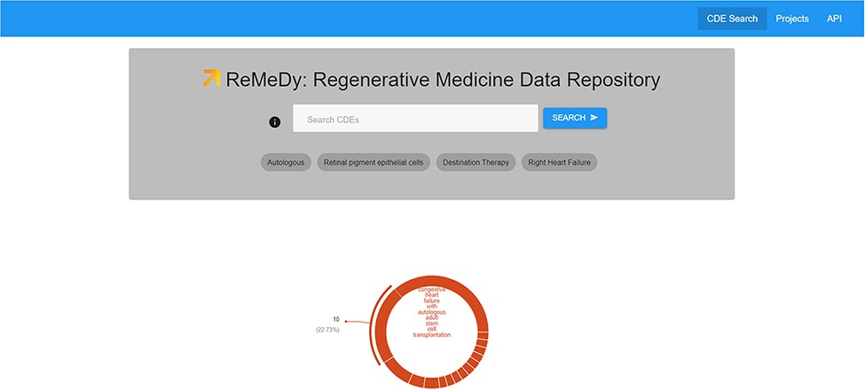
Figure 6. ReMeDy landing page. This image shows the search space, visualization tools, the API platform and Project ...
Notes:
Figure 6. ReMeDy landing page. This image shows the search space, visualization tools, the API platform and Project links functionalities accessible though the landing page.
Unless provided in the caption above, the following copyright applies to the content of this slide: © The Author(s) 2021. Published by Oxford University Press.This is an Open Access article distributed under the terms of the Creative Commons Attribution License (http://creativecommons.org/licenses/by/4.0/), which permits unrestricted reuse, distribution, and reproduction in any medium, provided the original work is properly cited.

