Slide 1
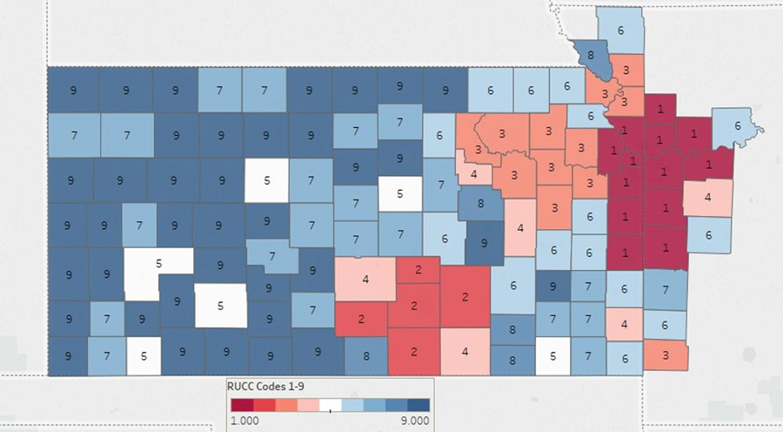
Figure 3 The University of Kansas Cancer Center Catchment Area. Color coding classifies counties by population ...
Notes:
Figure 3 The University of Kansas Cancer Center Catchment Area. Color coding classifies counties by population density. Urban (150.0 persons per square mile (ppsm) or more), semi-urban (40–149.9 ppsm), densely settled rural (20–39.9 ppsm), rural (6–19.9 ppsm) and frontier (<6 ppsm).
Unless provided in the caption above, the following copyright applies to the content of this slide: © The Author(s) 2020. Published by Oxford University Press.This is an Open Access article distributed under the terms of the Creative Commons Attribution License (http://creativecommons.org/licenses/by/4.0/), which permits unrestricted reuse, distribution, and reproduction in any medium, provided the original work is properly cited.

