Slide 1
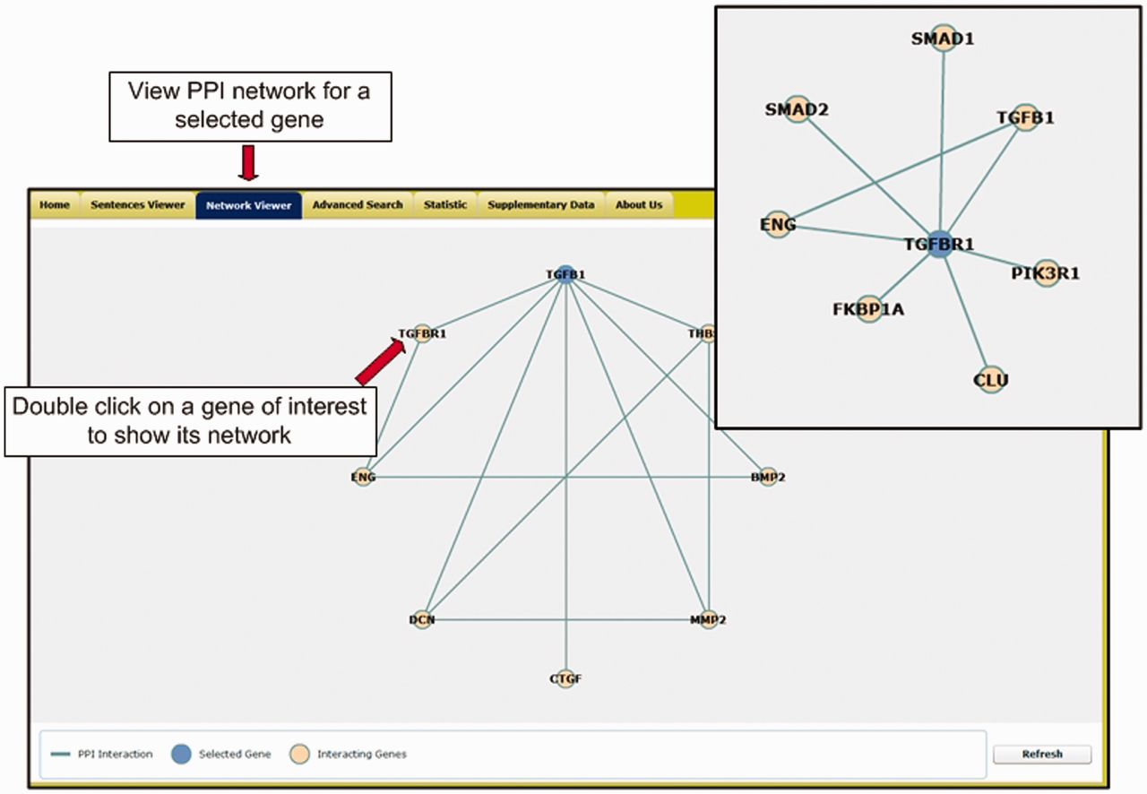
Figure 3 The network viewer of the T-HOD.
Notes:
Figure 3 The network viewer of the T-HOD.
Unless provided in the caption above, the following copyright applies to the content of this slide: © The Author(s) 2013. Published by Oxford University Press.This is an Open Access article distributed under the terms of the Creative Commons Attribution Non-Commercial License (http://creativecommons.org/licenses/by-nc/3.0/), which permits unrestricted non-commercial use, distribution, and reproduction in any medium, provided the original work is properly cited.

Slide 2
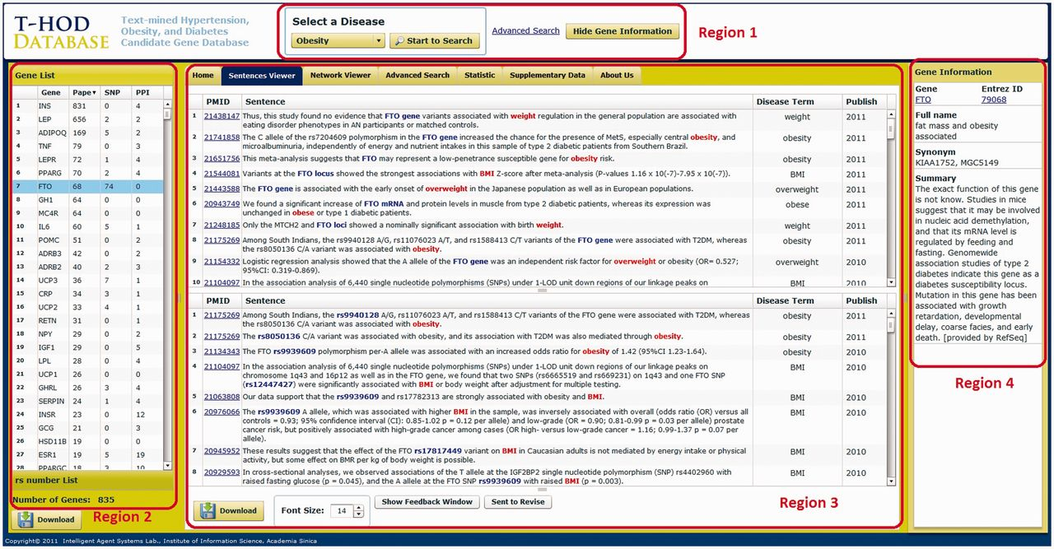
Figure 2 User interface of the T-HOD. The user interface is divided into four regions for precise introduction.
Notes:
Figure 2 User interface of the T-HOD. The user interface is divided into four regions for precise introduction.
Unless provided in the caption above, the following copyright applies to the content of this slide: © The Author(s) 2013. Published by Oxford University Press.This is an Open Access article distributed under the terms of the Creative Commons Attribution Non-Commercial License (http://creativecommons.org/licenses/by-nc/3.0/), which permits unrestricted non-commercial use, distribution, and reproduction in any medium, provided the original work is properly cited.

Slide 3
Figure 1 Statistics of the extracted hypertension candidate genes. The blue bars indicate the number of genes ...
Notes:
Figure 1 Statistics of the extracted hypertension candidate genes. The blue bars indicate the number of genes extracted each year, while the yellow bars specify the number of novel genes discovered each year.
Unless provided in the caption above, the following copyright applies to the content of this slide: © The Author(s) 2013. Published by Oxford University Press.This is an Open Access article distributed under the terms of the Creative Commons Attribution Non-Commercial License (http://creativecommons.org/licenses/by-nc/3.0/), which permits unrestricted non-commercial use, distribution, and reproduction in any medium, provided the original work is properly cited.

Slide 4
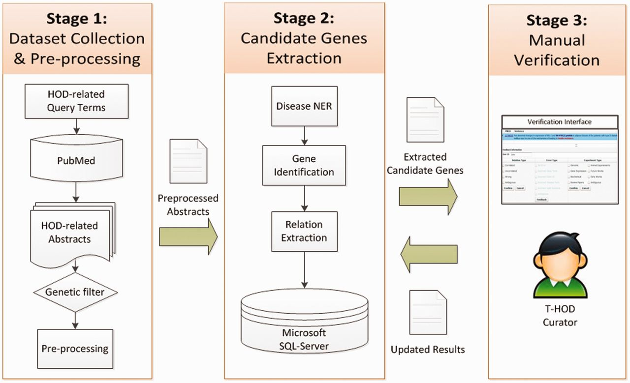
Figure 4 The flowchart of T-HOD construction.
Notes:
Figure 4 The flowchart of T-HOD construction.
Unless provided in the caption above, the following copyright applies to the content of this slide: © The Author(s) 2013. Published by Oxford University Press.This is an Open Access article distributed under the terms of the Creative Commons Attribution Non-Commercial License (http://creativecommons.org/licenses/by-nc/3.0/), which permits unrestricted non-commercial use, distribution, and reproduction in any medium, provided the original work is properly cited.

Slide 5
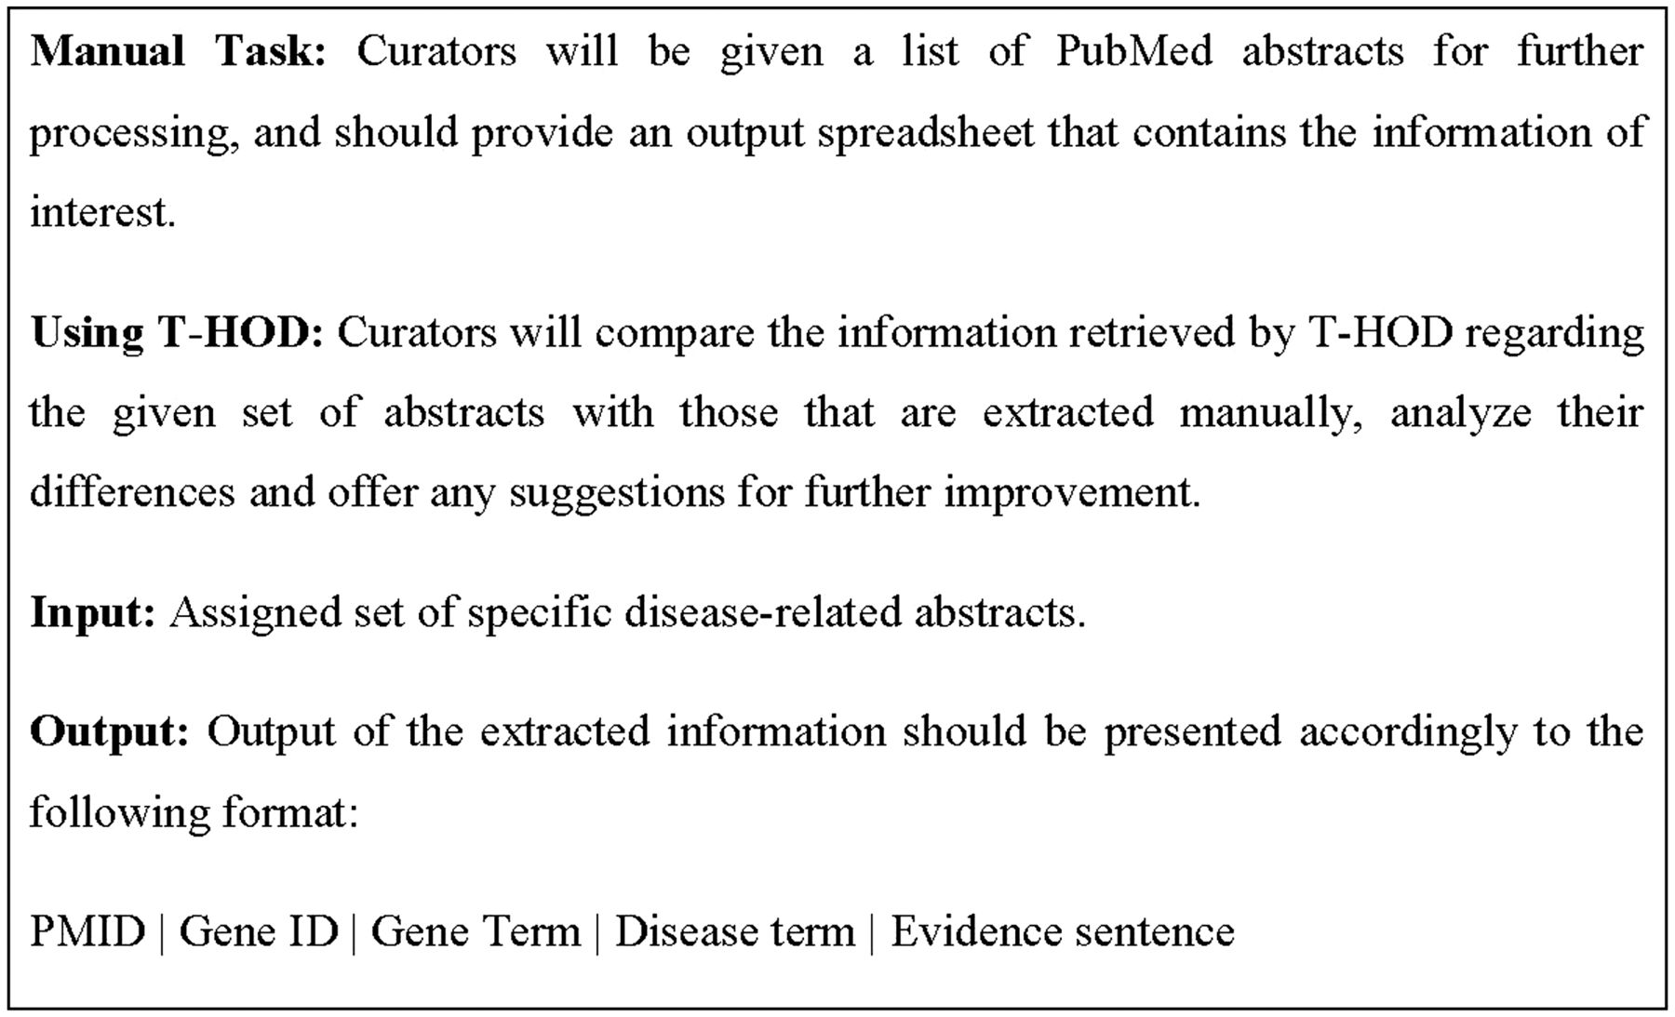
Figure 5 Illustration of the proposed task for biocurators.
Notes:
Figure 5 Illustration of the proposed task for biocurators.
Unless provided in the caption above, the following copyright applies to the content of this slide: © The Author(s) 2013. Published by Oxford University Press.This is an Open Access article distributed under the terms of the Creative Commons Attribution Non-Commercial License (http://creativecommons.org/licenses/by-nc/3.0/), which permits unrestricted non-commercial use, distribution, and reproduction in any medium, provided the original work is properly cited.

Slide 6
Figure 6 The interface for biocurators.
Notes:
Figure 6 The interface for biocurators.
Unless provided in the caption above, the following copyright applies to the content of this slide: © The Author(s) 2013. Published by Oxford University Press.This is an Open Access article distributed under the terms of the Creative Commons Attribution Non-Commercial License (http://creativecommons.org/licenses/by-nc/3.0/), which permits unrestricted non-commercial use, distribution, and reproduction in any medium, provided the original work is properly cited.

