Slide 1
Figure 3. Preprint usage over time. The number of studies published in a given month stratified by whether they at some ...
Notes:
Figure 3. Preprint usage over time. The number of studies published in a given month stratified by whether they at some point were deposited to bioRxiv. (Including studies currently only available on bioRxiv).
Unless provided in the caption above, the following copyright applies to the content of this slide: © The Author(s) 2020. Published by Oxford University Press.This is an Open Access article distributed under the terms of the Creative Commons Attribution License (http://creativecommons.org/licenses/by/4.0/), which permits unrestricted reuse, distribution, and reproduction in any medium, provided the original work is properly cited.

Slide 2
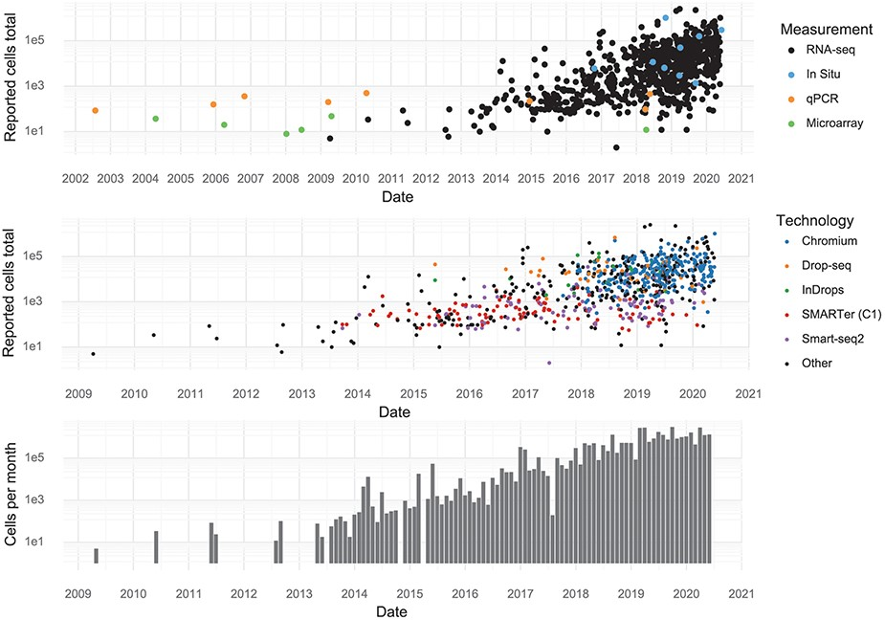
Figure 2. Scale of experiments and data over time. (Upper): The number of cells measured in a study, stratified by the ...
Notes:
Figure 2. Scale of experiments and data over time. (Upper): The number of cells measured in a study, stratified by the measurement method. (Middle): The number of cells measured in scRNA-seq experiments, stratified by scRNA-seq protocol. (Lower): The aggregate number of cells measured per month.
Unless provided in the caption above, the following copyright applies to the content of this slide: © The Author(s) 2020. Published by Oxford University Press.This is an Open Access article distributed under the terms of the Creative Commons Attribution License (http://creativecommons.org/licenses/by/4.0/), which permits unrestricted reuse, distribution, and reproduction in any medium, provided the original work is properly cited.

Slide 3
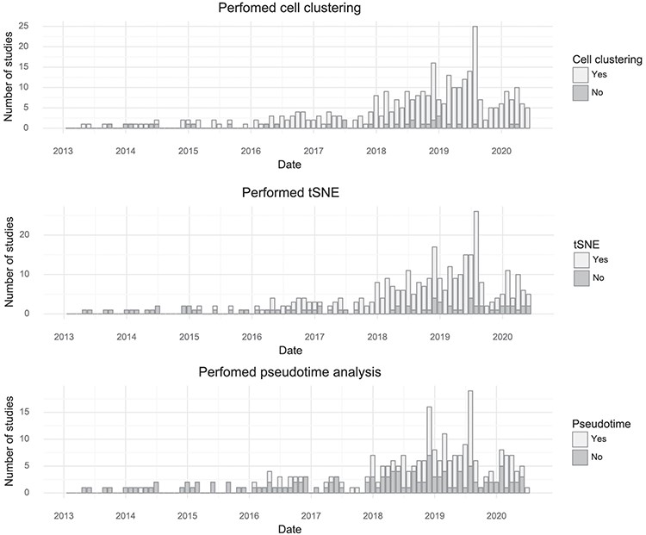
Figure 4. Popularity of forms of analysis over time. (Top) The number of studies doing clustering per month. (Middle) ...
Notes:
Figure 4. Popularity of forms of analysis over time. (Top) The number of studies doing clustering per month. (Middle) The number of studies using t-SNE per month. (Bottom) The number of studies doing pseudotime analysis per month.
Unless provided in the caption above, the following copyright applies to the content of this slide: © The Author(s) 2020. Published by Oxford University Press.This is an Open Access article distributed under the terms of the Creative Commons Attribution License (http://creativecommons.org/licenses/by/4.0/), which permits unrestricted reuse, distribution, and reproduction in any medium, provided the original work is properly cited.

Slide 4
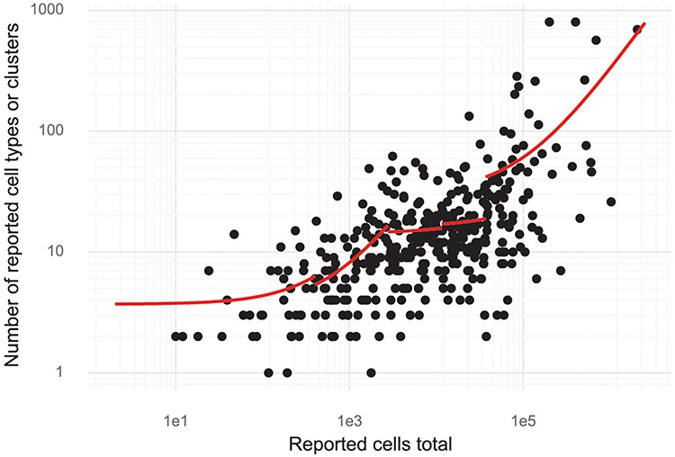
Figure 5. Cluster and cell numbers. The number of cells studied versus the number of clusters or cell types reported in ...
Notes:
Figure 5. Cluster and cell numbers. The number of cells studied versus the number of clusters or cell types reported in a study. Red curves correspond to linear regression stratified to five quantiles of ‘Reported cells total’.
Unless provided in the caption above, the following copyright applies to the content of this slide: © The Author(s) 2020. Published by Oxford University Press.This is an Open Access article distributed under the terms of the Creative Commons Attribution License (http://creativecommons.org/licenses/by/4.0/), which permits unrestricted reuse, distribution, and reproduction in any medium, provided the original work is properly cited.

Slide 5
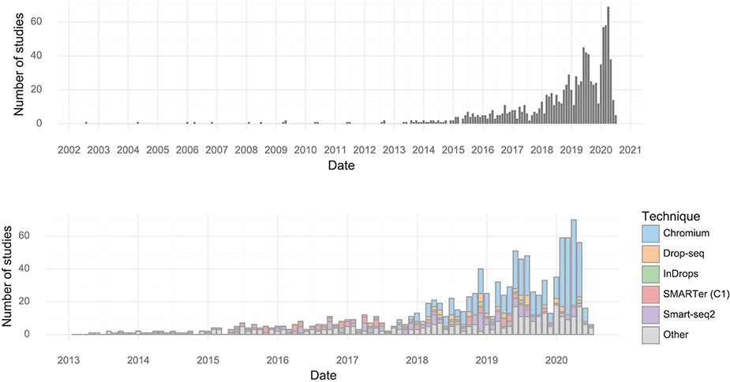
Figure 1. Studies over time. (Upper) The number of single-cell transcriptomics studies published per month. (Lower) The ...
Notes:
Figure 1. Studies over time. (Upper) The number of single-cell transcriptomics studies published per month. (Lower) The number of scRNA-seq studies published per month stratified by method.
Unless provided in the caption above, the following copyright applies to the content of this slide: © The Author(s) 2020. Published by Oxford University Press.This is an Open Access article distributed under the terms of the Creative Commons Attribution License (http://creativecommons.org/licenses/by/4.0/), which permits unrestricted reuse, distribution, and reproduction in any medium, provided the original work is properly cited.

