Slide 1
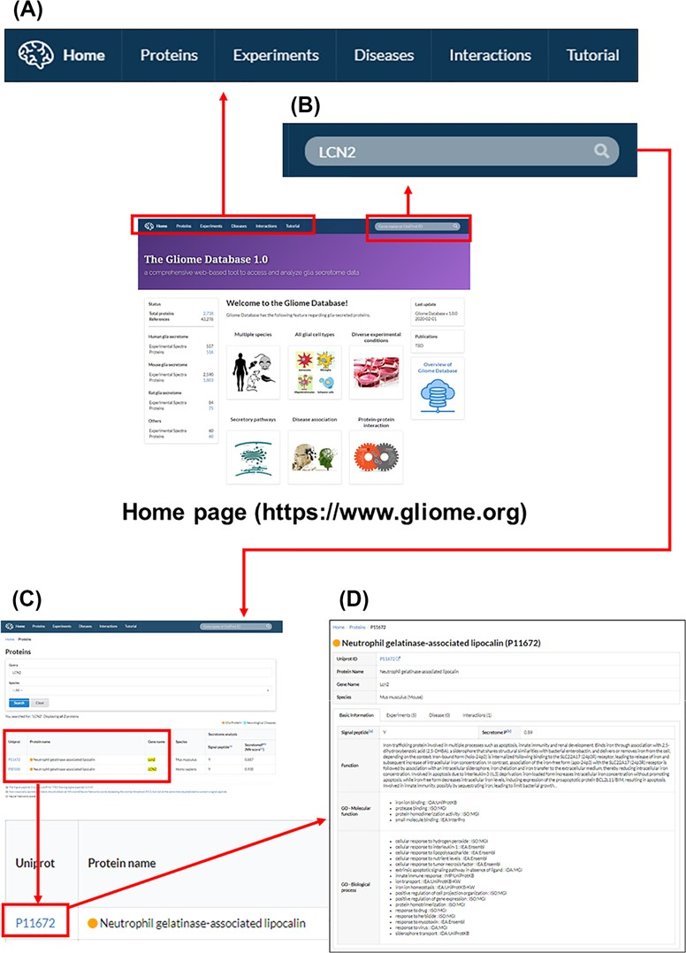
Figure 3 The main page and appearance of the Gliome database. (A) Main tabs, (B) quick search window, (C) protein ...
Notes:
Figure 3 The main page and appearance of the Gliome database. (A) Main tabs, (B) quick search window, (C) protein list, (D) protein information. When a user enters a protein name, such as ‘LCN2’, on the quick search window, the page of LCN2 protein appears. By clicking the UniProt ID, the relevant detailed information can be obtained.
Unless provided in the caption above, the following copyright applies to the content of this slide: © The Author(s) 2020. Published by Oxford University Press.This is an Open Access article distributed under the terms of the Creative Commons Attribution License (http://creativecommons.org/licenses/by/4.0/), which permits unrestricted reuse, distribution, and reproduction in any medium, provided the original work is properly cited.

