Slide 1
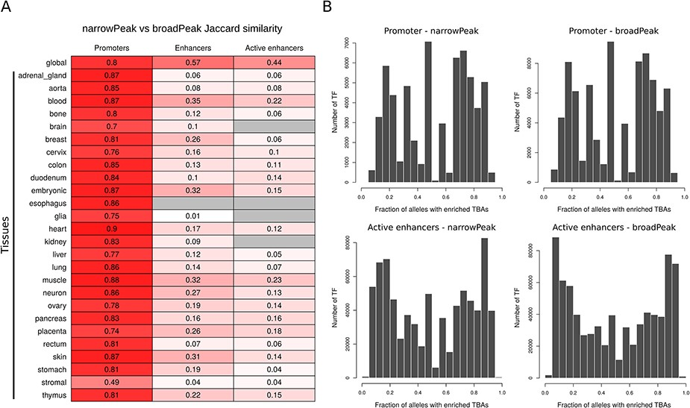
Figure 2. (A) Jaccard similarity of CREs derived from narrow versus broad peak data. Similarity is shown for global and ...
Notes:
Figure 2. (A) Jaccard similarity of CREs derived from narrow versus broad peak data. Similarity is shown for global and tissue CRE promoters, enhancers and active enhancers. Intensity of red color is proportional to the similarity index, while gray color indicates no comparison available. (B) Distribution of the number of TF presenting a specific enrichment fraction across 1000 Genomes Project common alleles for CRE promoters and active enhancers. Since the majority of TFs present a TBA enrichment fraction equal to 1, only TFs with TBA enrichment fraction <1 are depicted in the distribution.
Unless provided in the caption above, the following copyright applies to the content of this slide: © The Author(s) 2020. Published by Oxford University Press.This is an Open Access article distributed under the terms of the Creative Commons Attribution License (http://creativecommons.org/licenses/by/4.0/), which permits unrestricted reuse, distribution, and reproduction in any medium, provided the original work is properly cited.

