Slide 1
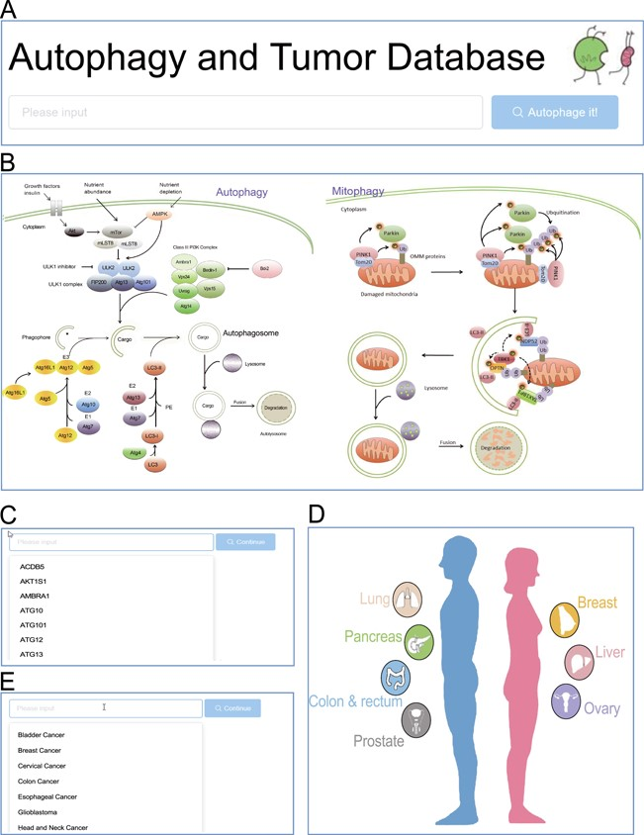
Figure 2 Browse entrance. (A) Search in the homepage; (B) click on the autophagy pathway illustration; (C) select from ...
Notes:
Figure 2 Browse entrance. (A) Search in the homepage; (B) click on the autophagy pathway illustration; (C) select from the dropdown list of genes; (D) click on the anatomy illustration; (E) select from the dropdown list of tumors.
Unless provided in the caption above, the following copyright applies to the content of this slide: © The Author(s) 2020. Published by Oxford University Press.This is an Open Access article distributed under the terms of the Creative Commons Attribution License (http://creativecommons.org/licenses/by/4.0/), which permits unrestricted reuse, distribution, and reproduction in any medium, provided the original work is properly cited.

