Slide 1
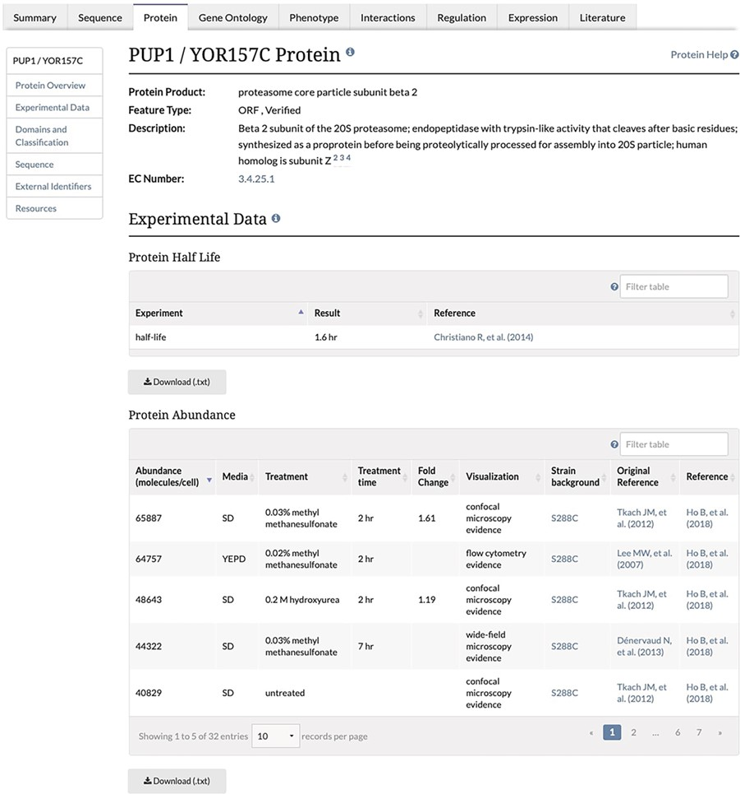
Figure 1 Experimental Data Section of the Protein Page. This section of the Protein page contains two tables, one ...
Notes:
Figure 1 Experimental Data Section of the Protein Page. This section of the Protein page contains two tables, one containing protein half-life data and the second containing the protein abundance data, and associated metadata, along with the original reference and the reference for the combined unified dataset. This table is both sortable and filterable.
Unless provided in the caption above, the following copyright applies to the content of this slide: © The Author(s) 2020. Published by Oxford University Press.This is an Open Access article distributed under the terms of the Creative Commons Attribution License (http://creativecommons.org/licenses/by/4.0/), which permits unrestricted reuse, distribution, and reproduction in any medium, provided the original work is properly cited.

