Slide 1
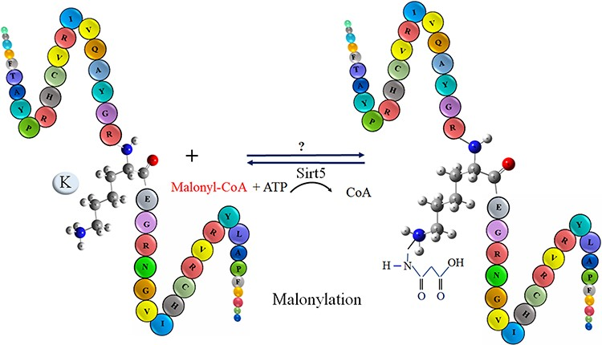
Figure 1. The schematic representation of malonylation process in a protein.
Notes:
Figure 1. The schematic representation of malonylation process in a protein.
Unless provided in the caption above, the following copyright applies to the content of this slide: © The Author(s) 2024. Published by Oxford University Press.This is an Open Access article distributed under the terms of the Creative Commons Attribution License (https://creativecommons.org/licenses/by/4.0/), which permits unrestricted reuse, distribution, and reproduction in any medium, provided the original work is properly cited.

Slide 2
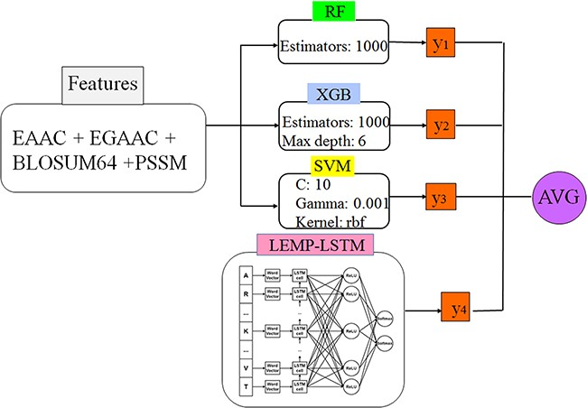
Figure 2. The proposed classifier as a hybrid model.
Notes:
Figure 2. The proposed classifier as a hybrid model.
Unless provided in the caption above, the following copyright applies to the content of this slide: © The Author(s) 2024. Published by Oxford University Press.This is an Open Access article distributed under the terms of the Creative Commons Attribution License (https://creativecommons.org/licenses/by/4.0/), which permits unrestricted reuse, distribution, and reproduction in any medium, provided the original work is properly cited.

Slide 3
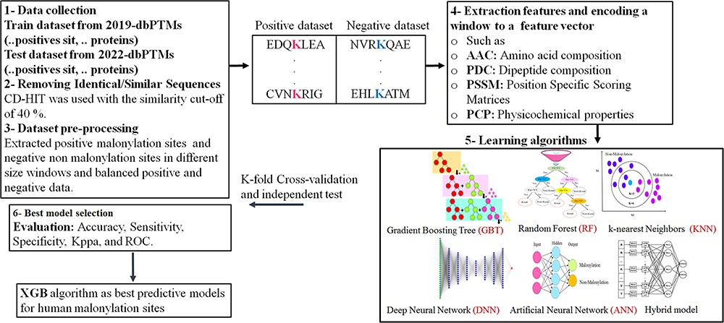
Figure 3. The schematic shows the ML/DL methods for prediction of malonylation sites in protein sequence: 1–3—data ...
Notes:
Figure 3. The schematic shows the ML/DL methods for prediction of malonylation sites in protein sequence: 1–3—data collection and dataset creation, 4—features extraction, 5—classifier models, 6—evaluation of the models.
Unless provided in the caption above, the following copyright applies to the content of this slide: © The Author(s) 2024. Published by Oxford University Press.This is an Open Access article distributed under the terms of the Creative Commons Attribution License (https://creativecommons.org/licenses/by/4.0/), which permits unrestricted reuse, distribution, and reproduction in any medium, provided the original work is properly cited.

Slide 4
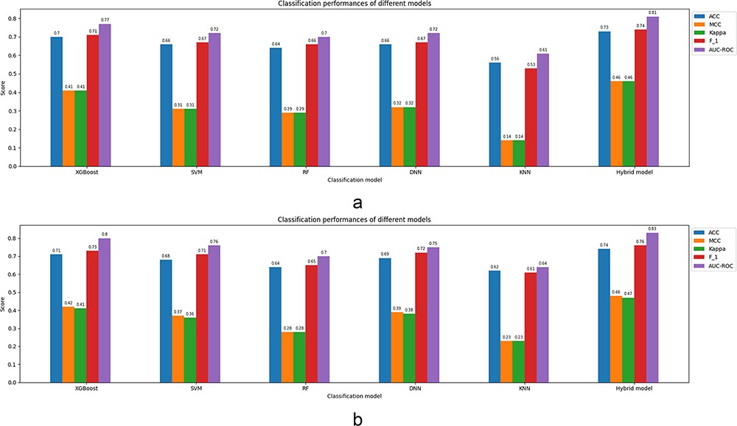
Figure 4. Classification parameters corresponding to the prediction models fed by the full feature set ...
Notes:
Figure 4. Classification parameters corresponding to the prediction models fed by the full feature set (EAAC + EGAAC + BLOSUM62 + PSSM) of window size 35 for both cases: 5-fold CV and independent test. (a) Results corresponding to a 5-fold CV. (b) Results corresponding to an independent test.
Unless provided in the caption above, the following copyright applies to the content of this slide: © The Author(s) 2024. Published by Oxford University Press.This is an Open Access article distributed under the terms of the Creative Commons Attribution License (https://creativecommons.org/licenses/by/4.0/), which permits unrestricted reuse, distribution, and reproduction in any medium, provided the original work is properly cited.

Slide 5
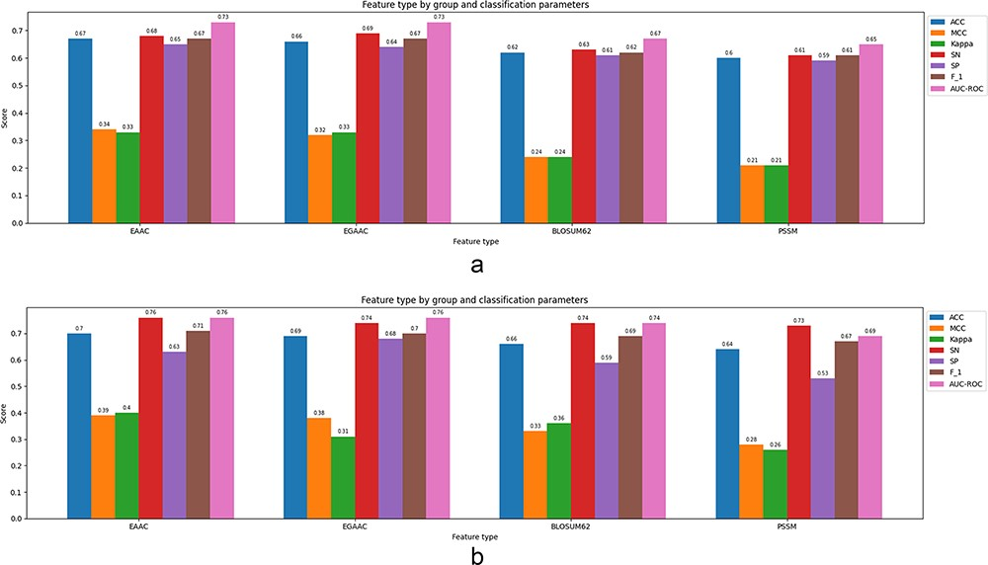
Figure 5. Classification parameters corresponding to the best-performing classification model (XGBoost) fed by the ...
Notes:
Figure 5. Classification parameters corresponding to the best-performing classification model (XGBoost) fed by the single feature of window size 35 for both cases: 5-fold cross-validation and independent test: (a) results corresponding to a 5-fold CV, (b) results corresponding to an independent test.
Unless provided in the caption above, the following copyright applies to the content of this slide: © The Author(s) 2024. Published by Oxford University Press.This is an Open Access article distributed under the terms of the Creative Commons Attribution License (https://creativecommons.org/licenses/by/4.0/), which permits unrestricted reuse, distribution, and reproduction in any medium, provided the original work is properly cited.

Slide 6
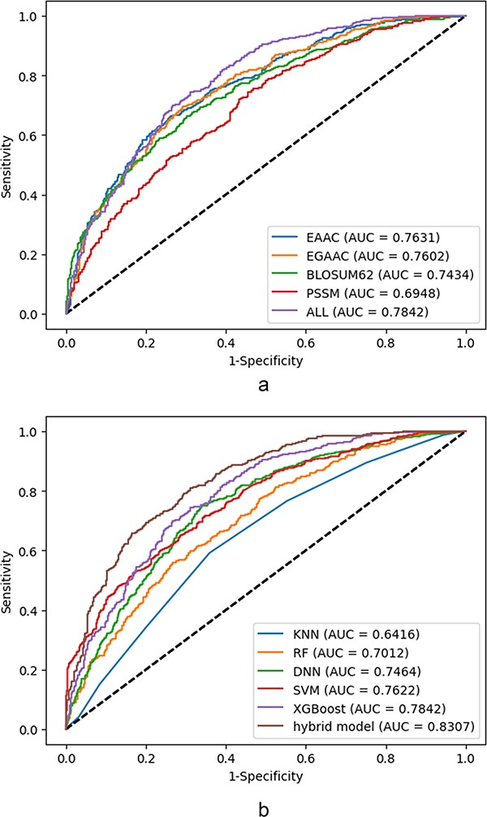
Figure 6. ROC curves corresponding to the individual feature and collective features: (a) ROCs corresponding to the ...
Notes:
Figure 6. ROC curves corresponding to the individual feature and collective features: (a) ROCs corresponding to the best utilized classifier (XGBoost) based on the single feature, (b) ROCs corresponding to the utilized classifiers at the presence of all features.
Unless provided in the caption above, the following copyright applies to the content of this slide: © The Author(s) 2024. Published by Oxford University Press.This is an Open Access article distributed under the terms of the Creative Commons Attribution License (https://creativecommons.org/licenses/by/4.0/), which permits unrestricted reuse, distribution, and reproduction in any medium, provided the original work is properly cited.

