Slide 1
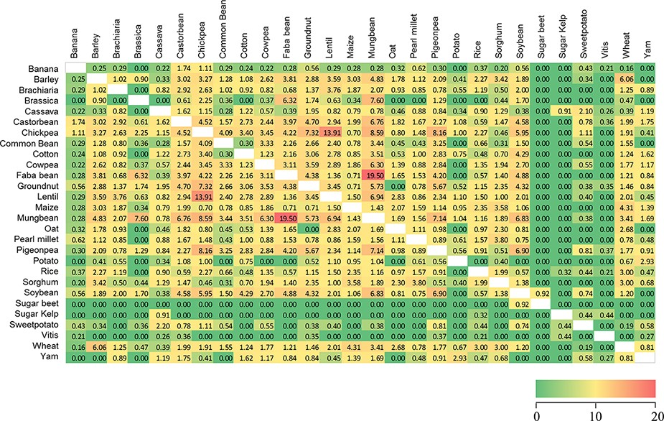
Figure 2. Similarity heatmap for the shared trait names across 28 Trait Dictionaries (TDs) in the Crop Ontology. Values ...
Notes:
Figure 2. Similarity heatmap for the shared trait names across 28 Trait Dictionaries (TDs) in the Crop Ontology. Values were calculated using the ‘simple matching coefficient’, colour gradient shading is relative to the pairwise percentage of trait names shared across the 28 TDs, with red indicating high values and green zero (Supplementary Table S3).
Unless provided in the caption above, the following copyright applies to the content of this slide: © The Author(s) 2021. Published by Oxford University Press.This is an Open Access article distributed under the terms of the Creative Commons Attribution License (http://creativecommons.org/licenses/by/4.0/), which permits unrestricted reuse, distribution, and reproduction in any medium, provided the original work is properly cited.

