Slide 1
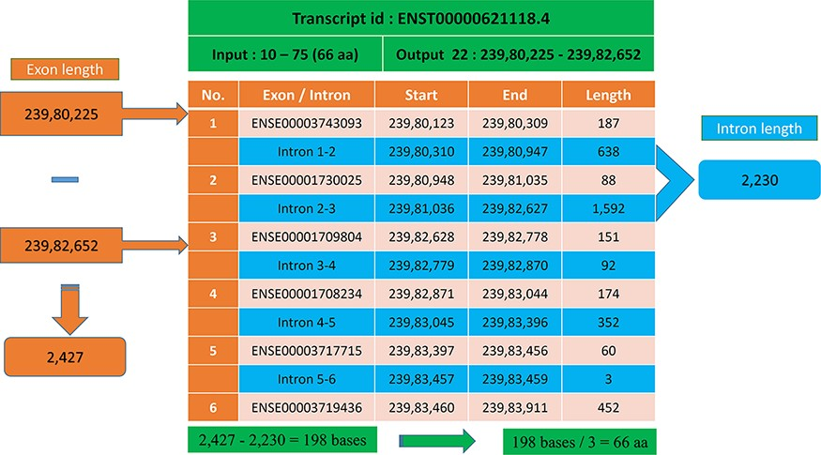
Figure 6. Transcript with multiple exons and introns. The Pfam domain GST_N length is 66aa, where the actual bases are ...
Notes:
Figure 6. Transcript with multiple exons and introns. The Pfam domain GST_N length is 66aa, where the actual bases are obtained by subtracting the intron length (blue) from the genomic positions (orange).
Unless provided in the caption above, the following copyright applies to the content of this slide: © The Author(s) 2021. Published by Oxford University Press.This is an Open Access article distributed under the terms of the Creative Commons Attribution License (https://creativecommons.org/licenses/by/4.0/), which permits unrestricted reuse, distribution, and reproduction in any medium, provided the original work is properly cited.

