Slide 1
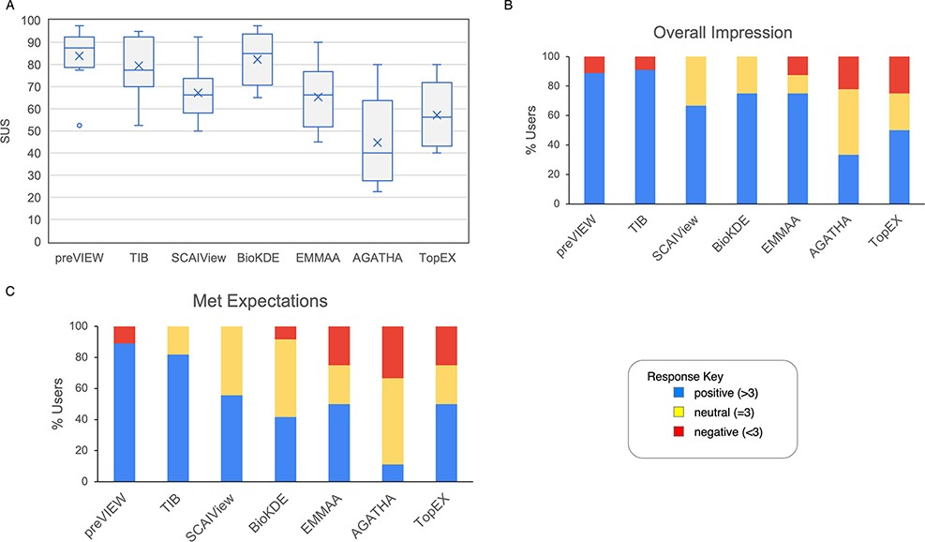
Figure 6. Results from questions evaluated with a Likert scale. (A) The boxplot represents the SUS distribution for ...
Notes:
Figure 6. Results from questions evaluated with a Likert scale. (A) The boxplot represents the SUS distribution for each system. The X represents the mean, the horizontal line within the box is the median and the circle is an outlier. (B) Aggregate response to the ‘Overall impression’ for the systems. Scores >3, <3 and =3 were labeled as positive, negative and neutral impression, respectively. (C) Aggregate response to the question ‘meeting expectations’.
Unless provided in the caption above, the following copyright applies to the content of this slide: © The Author(s) 2022. Published by Oxford University Press.This is an Open Access article distributed under the terms of the Creative Commons Attribution-NonCommercial License (https://creativecommons.org/licenses/by-nc/4.0/), which permits non-commercial re-use, distribution, and reproduction in any medium, provided the original work is properly cited. For commercial re-use, please contact journals.permissions@oup.com

