Slide 1
Figure 1. Description of the workflow. The workflow to build the database consists of three main steps. First, modeling ...
Notes:
Figure 1. Description of the workflow. The workflow to build the database consists of three main steps. First, modeling the effect of the drug treatments on individual genes in every cell line. Differential expression analysis was applied using Limma to compare the gene expression between the treatment and control conditions. Second, scoring the fold change and P-values from the differential expression to calculate the network perturbation amplitudes (NPA) of the drugs on each network (NPA) and each node (nodes contributions). The sum of the NPA for a group of networks is known as the biological impact factor (BIF). Finally, the BIF, NPA and nodes contributions were packaged in a database file and metadata of the cell lines, drugs and networks.
Unless provided in the caption above, the following copyright applies to the content of this slide: © The Author(s) 2021. Published by Oxford University Press.This is an Open Access article distributed under the terms of the Creative Commons Attribution License (http://creativecommons.org/licenses/by/4.0/), which permits unrestricted reuse, distribution, and reproduction in any medium, provided the original work is properly cited.

Slide 2
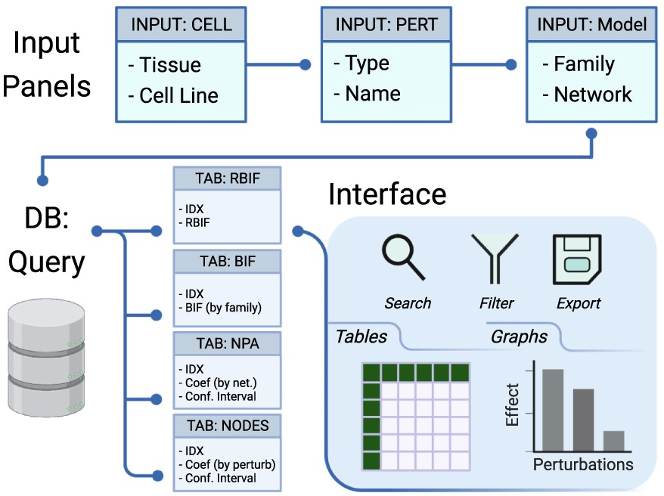
Figure 2. Description of the database and the interface. The interface includes input panels to query the database, and ...
Notes:
Figure 2. Description of the database and the interface. The interface includes input panels to query the database, and the output is sent back to the interface. The query is constructed by selecting the cell lines from one or more tissues, the drug perturbations grouped by mechanism of action, and the network models of interest. The output of the database query is three main tables: the BIF, NPA and code contributions (NODES). The output is returned in tabular and graphical formats that can be searched, filtered or exported.
Unless provided in the caption above, the following copyright applies to the content of this slide: © The Author(s) 2021. Published by Oxford University Press.This is an Open Access article distributed under the terms of the Creative Commons Attribution License (http://creativecommons.org/licenses/by/4.0/), which permits unrestricted reuse, distribution, and reproduction in any medium, provided the original work is properly cited.

Slide 3
Figure 3. The web interface input panel. The interface contains a main input panel which is divided into three parts. ...
Notes:
Figure 3. The web interface input panel. The interface contains a main input panel which is divided into three parts. (A) Cell is to choose the tissue and cellular context where the drug perturbations would be shown. (B) Perturbation allows for searching and selecting the type (mechanism of action) and name of the drugs of interest. (C) Network lists the available biological networks to be scored classified into multiple families. Multiple choices, resting and selecting a few entries at random are allowed. In this use case, five ‘Abl kinase inhibitors’ (‘AT-9283, imatinib, nilotinib, tozasertib and ZM-306 416’) were selected to check whether they perturb the cell proliferation (‘CPR’) through the ‘cell cycle’ and ‘Jak-Stat’ biological networks in five (‘A375, A549, PC3, HEPG2 and MCF7’) cancer cell lines.
Unless provided in the caption above, the following copyright applies to the content of this slide: © The Author(s) 2021. Published by Oxford University Press.This is an Open Access article distributed under the terms of the Creative Commons Attribution License (http://creativecommons.org/licenses/by/4.0/), which permits unrestricted reuse, distribution, and reproduction in any medium, provided the original work is properly cited.

Slide 4
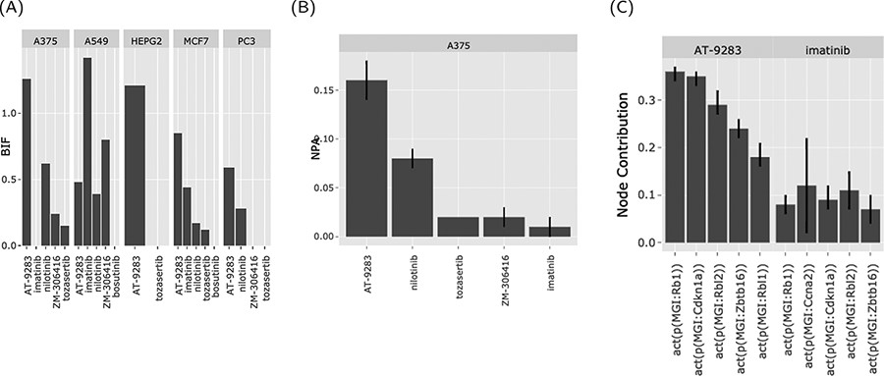
Figure 4. The web interface graphical output. The output of the ‘Abl kinase inhibitors’ on the CPR networks in five ...
Notes:
Figure 4. The web interface graphical output. The output of the ‘Abl kinase inhibitors’ on the CPR networks in five cancer cell lines (as selected in Figure 3). (A) BIF of every drug on the CPR networks stratified by the cell line. (B) NPA of every drug on the ‘cell cycle’ biological network in A375. (C) The relative contribution of each node (top five) in the cell cycle network in response to the drug perturbations in A375.
Unless provided in the caption above, the following copyright applies to the content of this slide: © The Author(s) 2021. Published by Oxford University Press.This is an Open Access article distributed under the terms of the Creative Commons Attribution License (http://creativecommons.org/licenses/by/4.0/), which permits unrestricted reuse, distribution, and reproduction in any medium, provided the original work is properly cited.

Slide 5
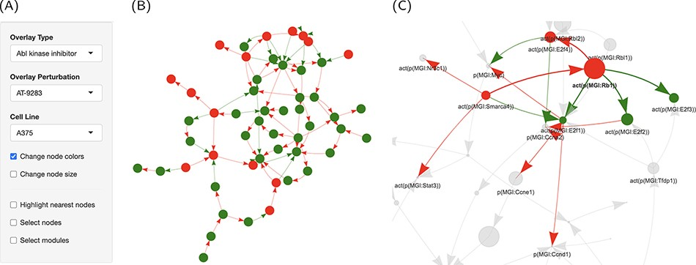
Figure 5. Graph representation of the network perturbations. (A) Input panel to search and select from the main inputs ...
Notes:
Figure 5. Graph representation of the network perturbations. (A) Input panel to search and select from the main inputs for individual perturbations to visualize on the network graph. (B) The ‘cell cycle’ network shown as a graph overlaid with the effect of ‘AT-9283’ in the ‘A375’ cell line. (C) The same with the highlighted cluster. Nodes are colored by the direction of regulation in response to the drug treatment (red, up, and green, down-regulated). Edges are colored by regulation direction between the nodes (red, increase; and green, decrease).
Unless provided in the caption above, the following copyright applies to the content of this slide: © The Author(s) 2021. Published by Oxford University Press.This is an Open Access article distributed under the terms of the Creative Commons Attribution License (http://creativecommons.org/licenses/by/4.0/), which permits unrestricted reuse, distribution, and reproduction in any medium, provided the original work is properly cited.

