Slide 1
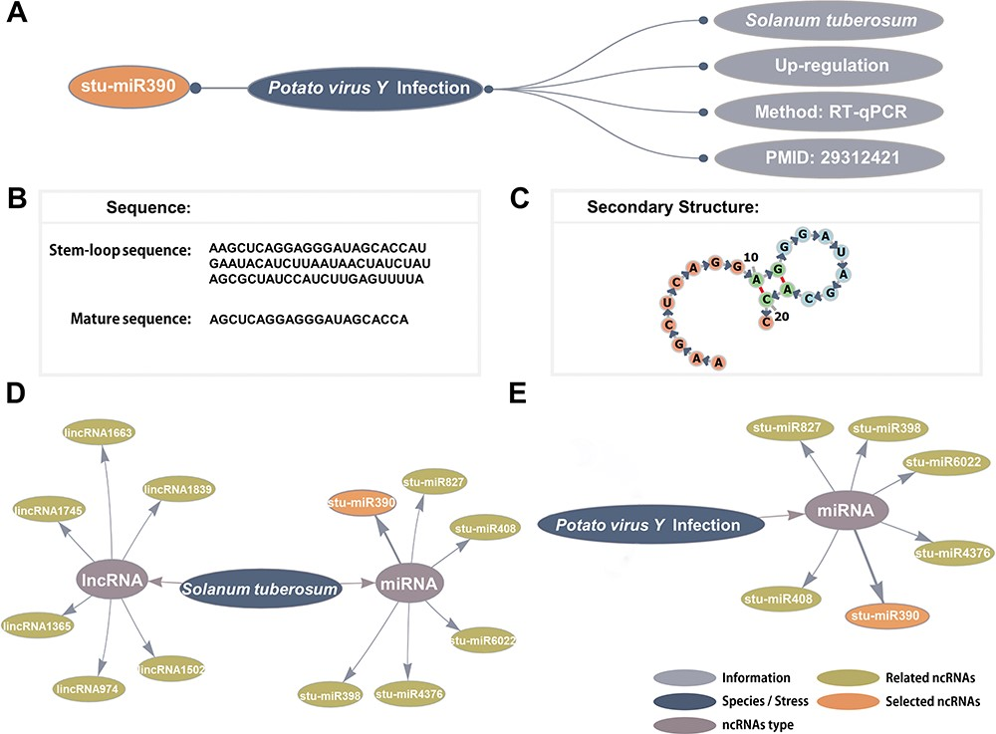
Figure 2 Detailed information and network visualization. (A) The basic information of stu-miR408. (B) The stem-loop ...
Notes:
Figure 2 Detailed information and network visualization. (A) The basic information of stu-miR408. (B) The stem-loop sequence and mature sequence of stu-miR390. (C) The secondary structure of stu-miR390. (D) The S. tuberosum–ncRNAs network. (E) The Potato virus Y infection–ncRNAs network.
Unless provided in the caption above, the following copyright applies to the content of this slide: © The Author(s) 2020. Published by Oxford University Press.This is an Open Access article distributed under the terms of the Creative Commons Attribution License (http://creativecommons.org/licenses/by/4.0/), which permits unrestricted reuse, distribution, and reproduction in any medium, provided the original work is properly cited.

