Slide 1
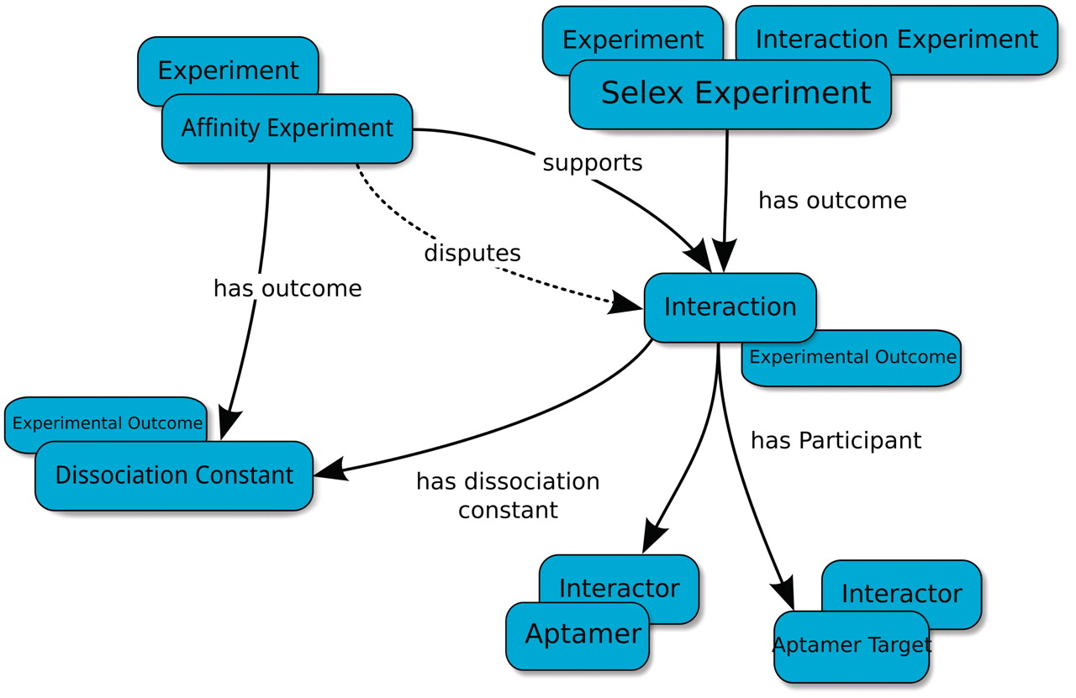
Figure 1. Basic type-relation map used by the Aptamer Base to describe SELEX experiments. The Interaction Experiment ...
Notes:
Figure 1. Basic type-relation map used by the Aptamer Base to describe SELEX experiments. The Interaction Experiment type ‘has outcome’ an Interaction. Each Interaction ‘has participant’ at least two Interactors (Aptamer and Aptamer Target). The Affinity Experiment type ‘has outcome’ a Dissociation Constant that either ‘confirms’ or ‘disputes’ an interaction. Blue ellipses denote types and arrows represent properties between topics. Overlapping ellipses represent the multiple types associated with a topic. For more details visit http://aptamerbase.semanticscience.org/?q=node/1.
Unless provided in the caption above, the following copyright applies to the content of this slide: © The Author(s) 2012. Published by Oxford University Press.This is an Open Access article distributed under the terms of the Creative Commons Attribution Non-Commercial License (http://creativecommons.org/licenses/by-nc/3.0), which permits unrestricted non-commercial use, distribution, and reproduction in any medium, provided the original work is properly cited.

Slide 2
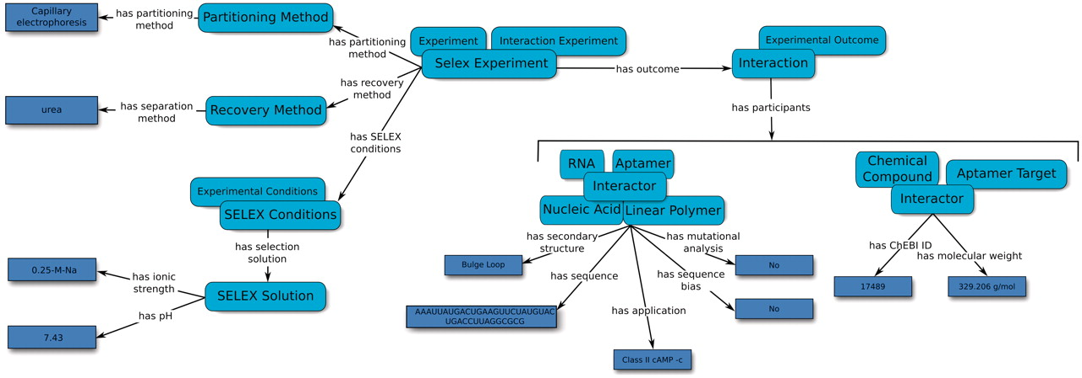
Figure 2. An overview of the relation map used by the Aptamer Base to describe SELEX experiments, the experimental ...
Notes:
Figure 2. An overview of the relation map used by the Aptamer Base to describe SELEX experiments, the experimental details and the resulting aptamers. Light blue ellipses denote types and arrows represent either properties between topics or between topics and values (dark blue rectangles).
Unless provided in the caption above, the following copyright applies to the content of this slide: © The Author(s) 2012. Published by Oxford University Press.This is an Open Access article distributed under the terms of the Creative Commons Attribution Non-Commercial License (http://creativecommons.org/licenses/by-nc/3.0), which permits unrestricted non-commercial use, distribution, and reproduction in any medium, provided the original work is properly cited.

Slide 3
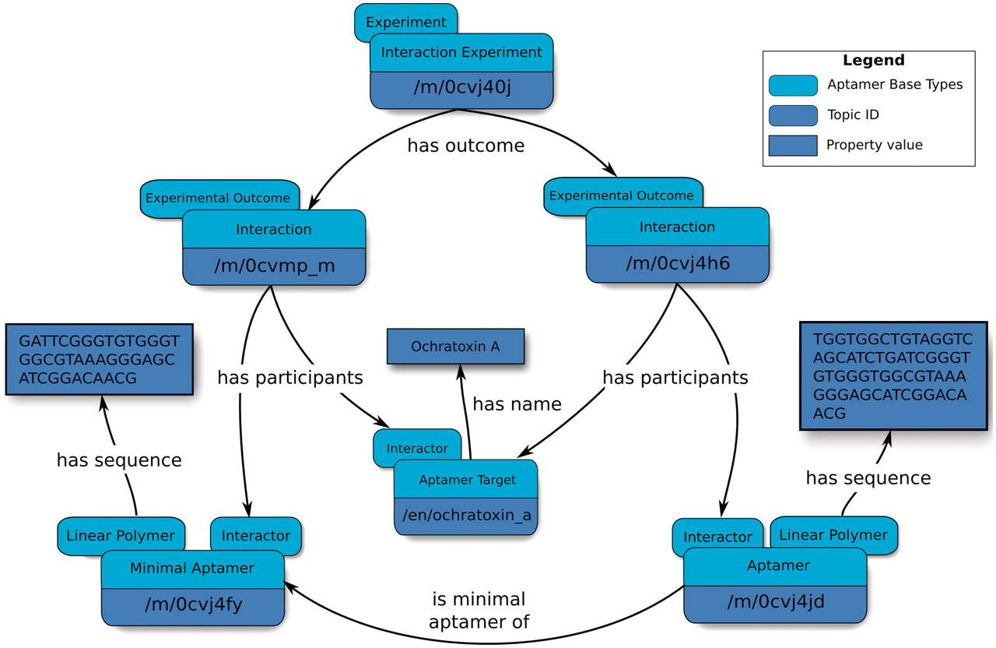
Figure 3. Overview of an abridged relation map describing minimal aptamers. Minimal aptamers are captured in the ...
Notes:
Figure 3. Overview of an abridged relation map describing minimal aptamers. Minimal aptamers are captured in the Aptamer Base by creating a new Interaction for each individual Minimal Aptamer, permitting the description of unique Aptamers can then be associated with the unique Interaction topics.
Unless provided in the caption above, the following copyright applies to the content of this slide: © The Author(s) 2012. Published by Oxford University Press.This is an Open Access article distributed under the terms of the Creative Commons Attribution Non-Commercial License (http://creativecommons.org/licenses/by-nc/3.0), which permits unrestricted non-commercial use, distribution, and reproduction in any medium, provided the original work is properly cited.

Slide 4
Figure 4. Summary of target types and aptamer types found in the Aptamer Base. (A) Distribution of the over 900 aptamer ...
Notes:
Figure 4. Summary of target types and aptamer types found in the Aptamer Base. (A) Distribution of the over 900 aptamer types described by the Aptamer Base. (B) Distribution of the 131 aptamer targets found in the Aptamer Base.
Unless provided in the caption above, the following copyright applies to the content of this slide: © The Author(s) 2012. Published by Oxford University Press.This is an Open Access article distributed under the terms of the Creative Commons Attribution Non-Commercial License (http://creativecommons.org/licenses/by-nc/3.0), which permits unrestricted non-commercial use, distribution, and reproduction in any medium, provided the original work is properly cited.

