Slide 1
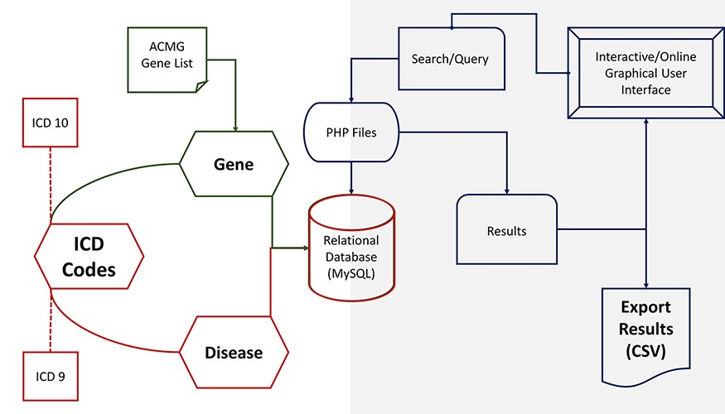
Figure 1. PAS-GDC components’ design, development and data flow. PAS-GDC is an online application developed using MySQL ...
Notes:
Figure 1. PAS-GDC components’ design, development and data flow. PAS-GDC is an online application developed using MySQL database, PHP scripting language and UNIX-based web and database servers.
Unless provided in the caption above, the following copyright applies to the content of this slide: © The Author(s) 2023. Published by Oxford University Press.This is an Open Access article distributed under the terms of the Creative Commons Attribution License (https://creativecommons.org/licenses/by/4.0/), which permits unrestricted reuse, distribution, and reproduction in any medium, provided the original work is properly cited.

