Slide 1
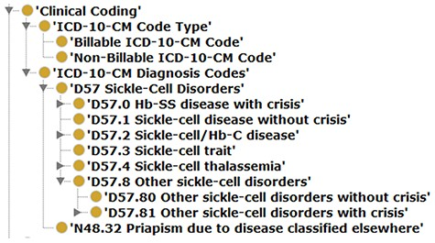
Figure 4. Illustrating a case of an updated SCDO concept—The ‘Clinical Coding’ class.
Notes:
Figure 4. Illustrating a case of an updated SCDO concept—The ‘Clinical Coding’ class.
Unless provided in the caption above, the following copyright applies to the content of this slide: © The Author(s) 2022. Published by Oxford University Press.This is an Open Access article distributed under the terms of the Creative Commons Attribution License (https://creativecommons.org/licenses/by/4.0/), which permits unrestricted reuse, distribution, and reproduction in any medium, provided the original work is properly cited.

Slide 2
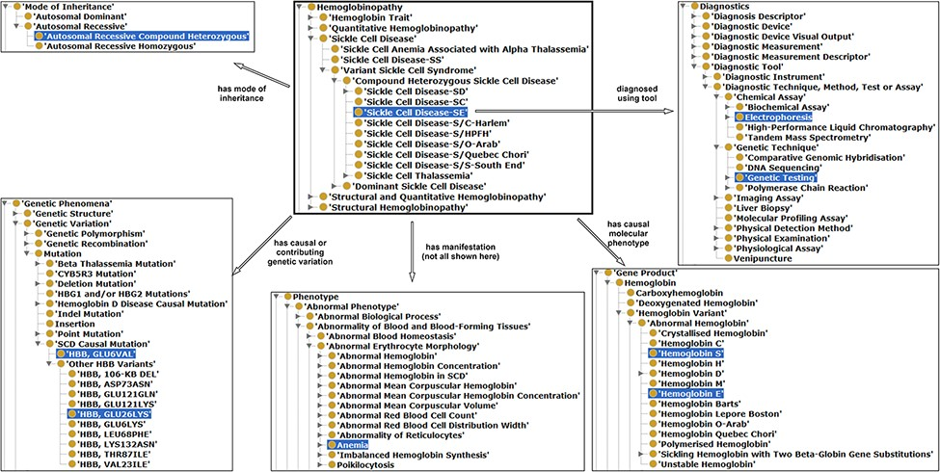
Figure 3. Illustration of properties between hemoglobinopathy concepts as an approach to integrating existing ...
Notes:
Figure 3. Illustration of properties between hemoglobinopathy concepts as an approach to integrating existing hemoglobinopathy knowledge. The ‘Sickle Cell Disease-SE’ class is the reference or the object, a subclass of hemoglobinopathy having some properties (annotation in different arrows) related with other classes (subjects) highlighted in blue.
Unless provided in the caption above, the following copyright applies to the content of this slide: © The Author(s) 2022. Published by Oxford University Press.This is an Open Access article distributed under the terms of the Creative Commons Attribution License (https://creativecommons.org/licenses/by/4.0/), which permits unrestricted reuse, distribution, and reproduction in any medium, provided the original work is properly cited.

Slide 3
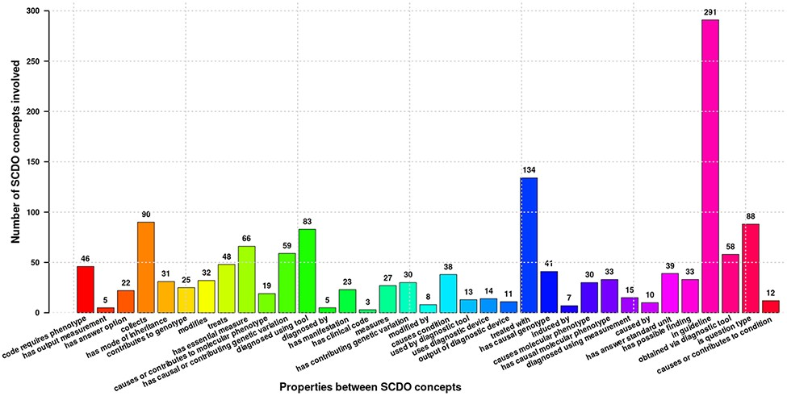
Figure 2. Different properties defined between SCDO concepts mapping the current SCD knowledge. Numbers at the top of ...
Notes:
Figure 2. Different properties defined between SCDO concepts mapping the current SCD knowledge. Numbers at the top of bars represent the frequency of occurrence of the association in the ontology.
Unless provided in the caption above, the following copyright applies to the content of this slide: © The Author(s) 2022. Published by Oxford University Press.This is an Open Access article distributed under the terms of the Creative Commons Attribution License (https://creativecommons.org/licenses/by/4.0/), which permits unrestricted reuse, distribution, and reproduction in any medium, provided the original work is properly cited.

Slide 4
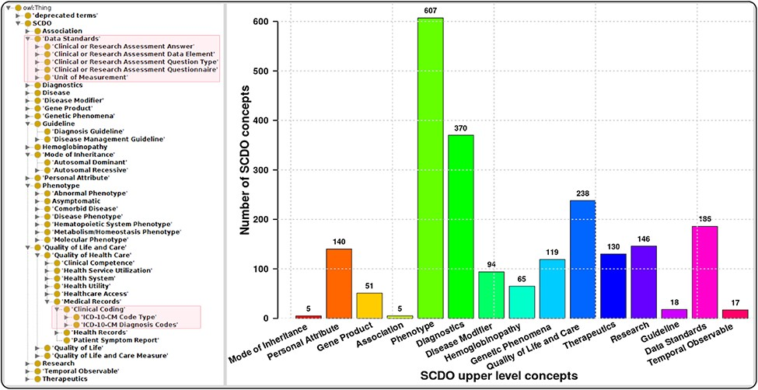
Figure 1. The SCDO tree view showing the hierarchical representation of knowledge on SCD with two main new concepts ...
Notes:
Figure 1. The SCDO tree view showing the hierarchical representation of knowledge on SCD with two main new concepts highlighted in the boxes on the left, and a bar graph showing the number of concepts under the different upper-level terms.
Unless provided in the caption above, the following copyright applies to the content of this slide: © The Author(s) 2022. Published by Oxford University Press.This is an Open Access article distributed under the terms of the Creative Commons Attribution License (https://creativecommons.org/licenses/by/4.0/), which permits unrestricted reuse, distribution, and reproduction in any medium, provided the original work is properly cited.

