Slide 1
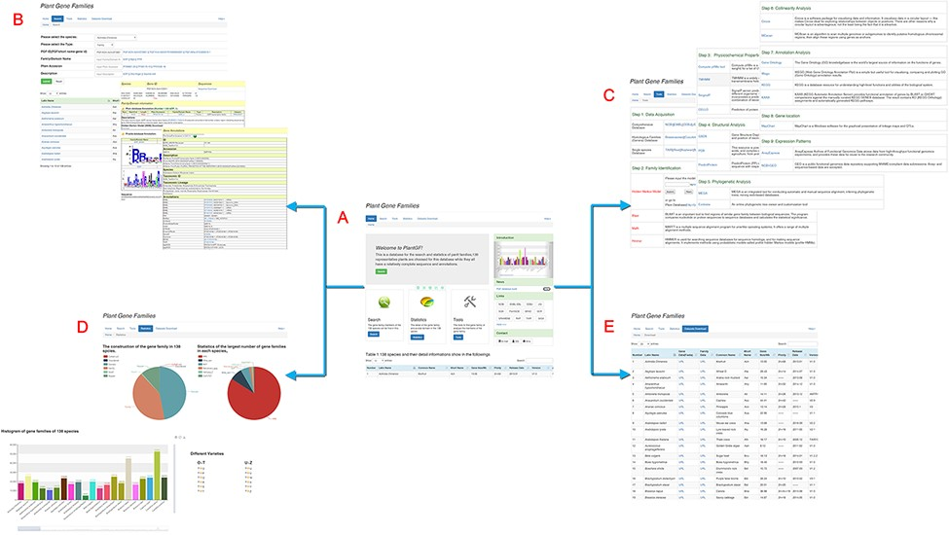
Figure 1. Main PlantGF web page. (A) PlantGF homepage: provides quick entry paths to all main parts. (B) Search: ...
Notes:
Figure 1. Main PlantGF web page. (A) PlantGF homepage: provides quick entry paths to all main parts. (B) Search: contains 2 909 580 gene family members and their specific detail annotations. (C) Tools: consists of nine steps in gene family analysis. Among that, four online tools (HMM-Search, BLAST, MAFFT and HMMER) also exist. (D) Statistics: statistics among these gene families. (E) Datasets Download: provides download links of 138 plant species’ protein sequences and their gene families.
Unless provided in the caption above, the following copyright applies to the content of this slide: © The Author(s) 2022. Published by Oxford University Press.This is an Open Access article distributed under the terms of the Creative Commons Attribution License (https://creativecommons.org/licenses/by/4.0/), which permits unrestricted reuse, distribution, and reproduction in any medium, provided the original work is properly cited.

Slide 2
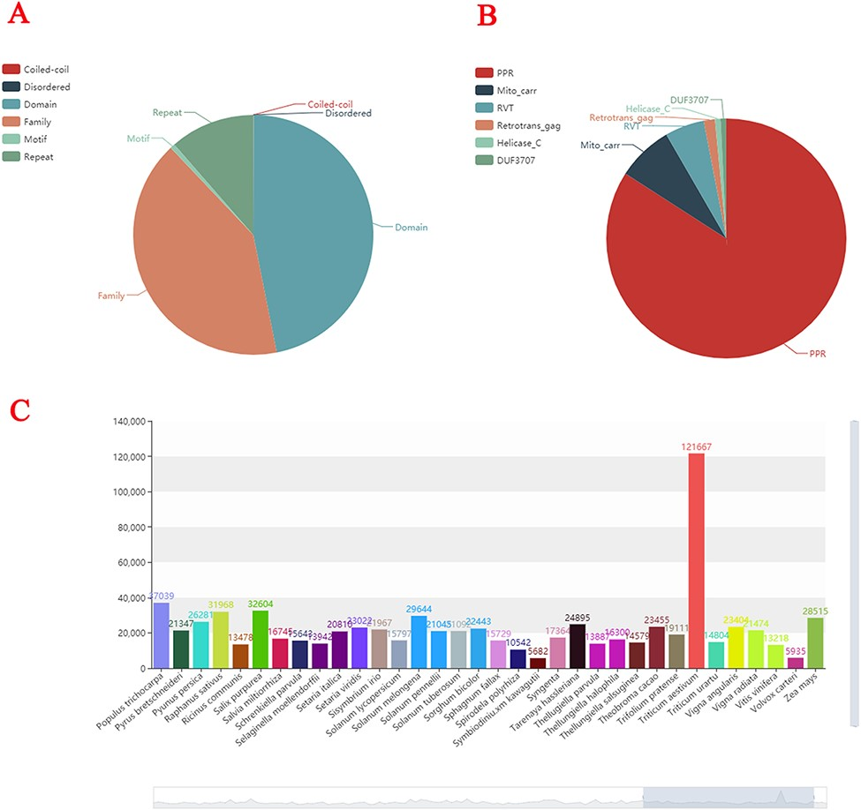
Figure 2. Statistics of plant gene families. (A) The composition structure of 138 plant species’ genes. (B) Statistics ...
Notes:
Figure 2. Statistics of plant gene families. (A) The composition structure of 138 plant species’ genes. (B) Statistics of the largest number of gene families in each species. (C) The number of gene families of each species.
Unless provided in the caption above, the following copyright applies to the content of this slide: © The Author(s) 2022. Published by Oxford University Press.This is an Open Access article distributed under the terms of the Creative Commons Attribution License (https://creativecommons.org/licenses/by/4.0/), which permits unrestricted reuse, distribution, and reproduction in any medium, provided the original work is properly cited.

