Slide 1
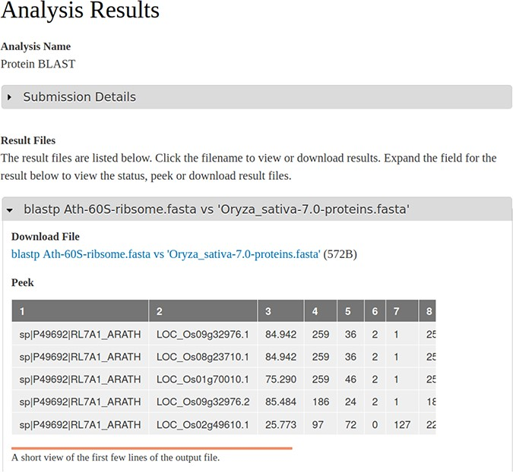
Figure 4 A screenshot of the results page resulting from an execution of the BLAST workflow that is shown in Figure 1 ...
Notes:
Figure 4 A screenshot of the results page resulting from an execution of the BLAST workflow that is shown in Figure 1 and submitted via the Tripal Galaxy module by an end user. The table in the ‘peek’ section is provided by the Galaxy server.
Unless provided in the caption above, the following copyright applies to the content of this slide: © The Author(s) 2020. Published by Oxford University Press.This is an Open Access article distributed under the terms of the Creative Commons Attribution License (http://creativecommons.org/licenses/by/4.0/), which permits unrestricted reuse, distribution, and reproduction in any medium, provided the original work is properly cited.

