Slide 1
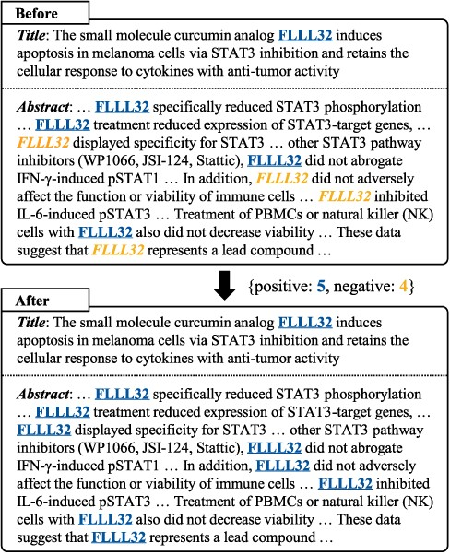
Figure 1. The tagging inconsistency problem and our majority voting method. We underline positive predictions and ...
Notes:
Figure 1. The tagging inconsistency problem and our majority voting method. We underline positive predictions and italicize negative predictions for the entity “FLLL32”. Our method improves tagging consistency by changing the minority to the majority.
Unless provided in the caption above, the following copyright applies to the content of this slide: © The Author(s) 2022. Published by Oxford University Press.This is an Open Access article distributed under the terms of the Creative Commons Attribution-NonCommercial License (https://creativecommons.org/licenses/by-nc/4.0/), which permits non-commercial re-use, distribution, and reproduction in any medium, provided the original work is properly cited. For commercial re-use, please contact journals.permissions@oup.com

