Slide 1
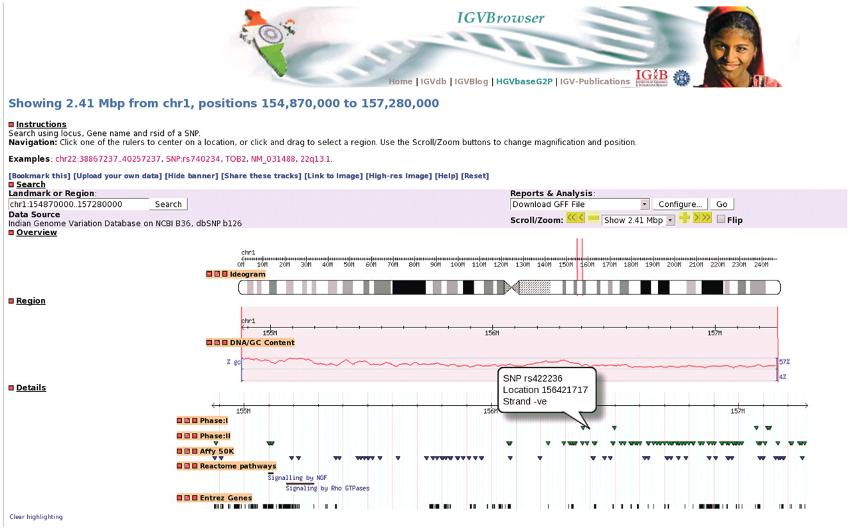
Figure 1. A representative example of IGVBrowser. Distribution of markers in 2.41 Mb region in human chromosome 1 from ...
Notes:
Figure 1. A representative example of IGVBrowser. Distribution of markers in 2.41 Mb region in human chromosome 1 from IGVC data is displayed along with annotation data from different resources.
Unless provided in the caption above, the following copyright applies to the content of this slide: © The Author(s) 2010. Published by Oxford University Press.This is Open Access article distributed under the terms of the Creative Commons Attribution Non-Commercial License (http://creativecommons.org/licenses/by-nc/2.5), which permits unrestricted non-commercial use, distribution, and reproduction in any medium, provided the original work is properly cited.

Slide 2
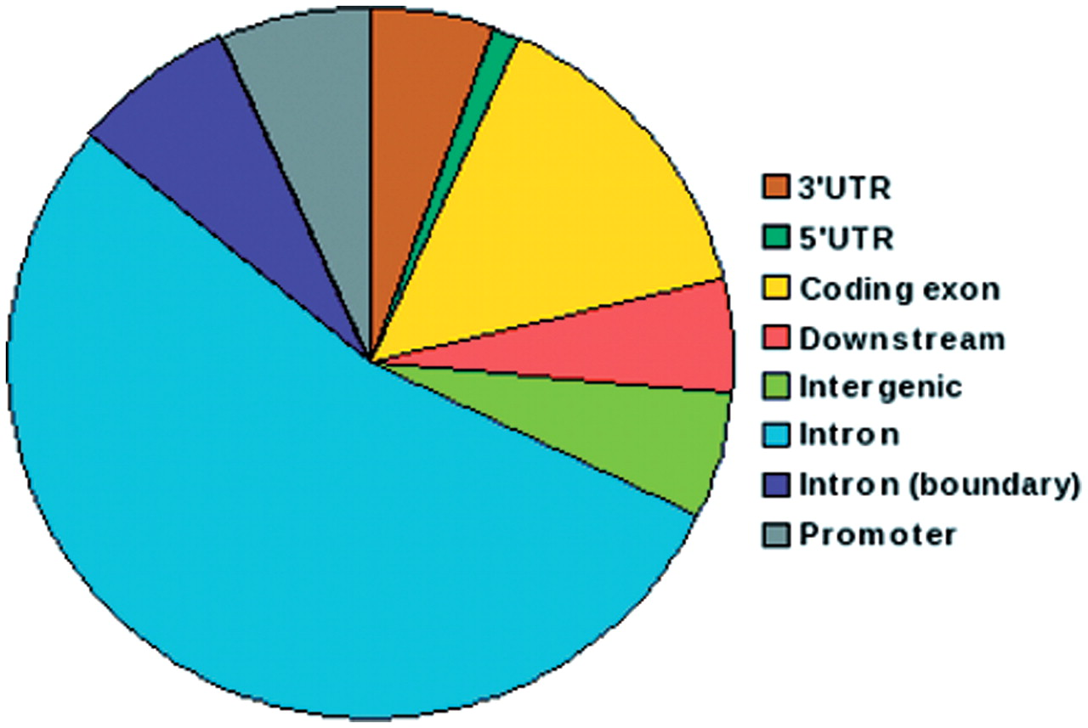
Figure 2. Pie chart depicting distribution of SNPs in IGVC according to genomic location. More than 50% of the SNPs ...
Notes:
Figure 2. Pie chart depicting distribution of SNPs in IGVC according to genomic location. More than 50% of the SNPs belong to intronic regions and 15% are in coding exons.
Unless provided in the caption above, the following copyright applies to the content of this slide: © The Author(s) 2010. Published by Oxford University Press.This is Open Access article distributed under the terms of the Creative Commons Attribution Non-Commercial License (http://creativecommons.org/licenses/by-nc/2.5), which permits unrestricted non-commercial use, distribution, and reproduction in any medium, provided the original work is properly cited.

Slide 3
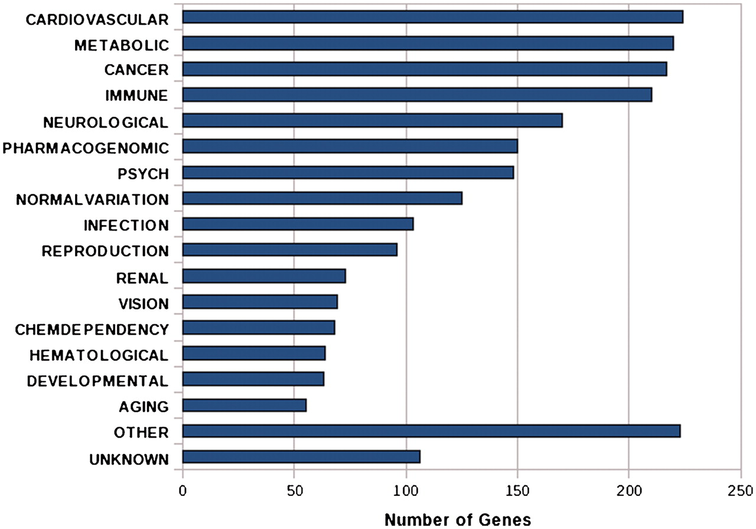
Figure 3. Bar graph shows the functional annotation of candidate genes in IGVC according to gene–disease association.
Notes:
Figure 3. Bar graph shows the functional annotation of candidate genes in IGVC according to gene–disease association.
Unless provided in the caption above, the following copyright applies to the content of this slide: © The Author(s) 2010. Published by Oxford University Press.This is Open Access article distributed under the terms of the Creative Commons Attribution Non-Commercial License (http://creativecommons.org/licenses/by-nc/2.5), which permits unrestricted non-commercial use, distribution, and reproduction in any medium, provided the original work is properly cited.

Slide 4
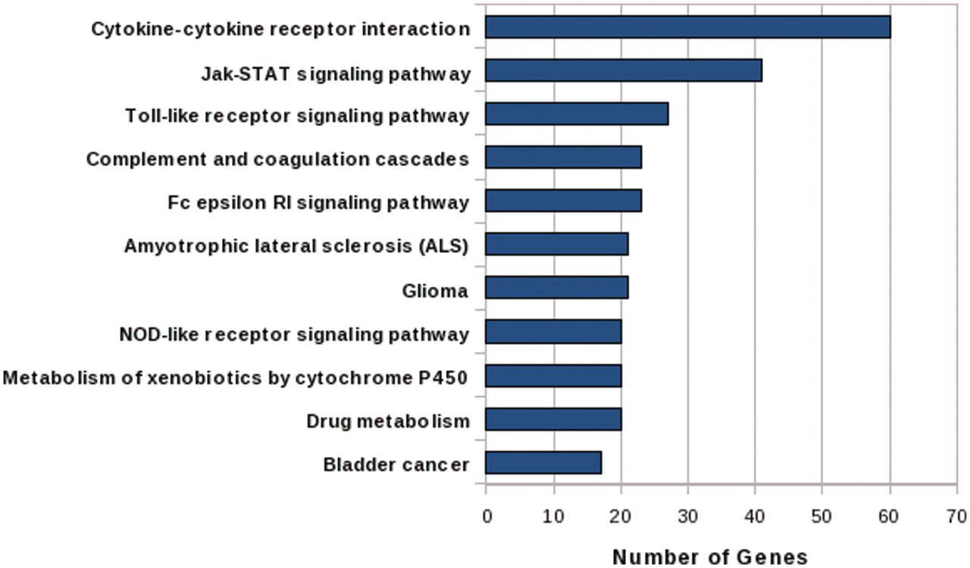
Figure 4. Bar graph shows the mapping of candidate genes in significant pathways (after Bonferroni correction) of KEGG ...
Notes:
Figure 4. Bar graph shows the mapping of candidate genes in significant pathways (after Bonferroni correction) of KEGG Pathway Database.
Unless provided in the caption above, the following copyright applies to the content of this slide: © The Author(s) 2010. Published by Oxford University Press.This is Open Access article distributed under the terms of the Creative Commons Attribution Non-Commercial License (http://creativecommons.org/licenses/by-nc/2.5), which permits unrestricted non-commercial use, distribution, and reproduction in any medium, provided the original work is properly cited.

